Slide 1

Association of Veterinary Anaesthetists
Update Spring 2026

Slide 2
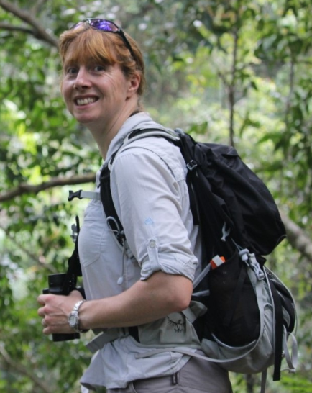
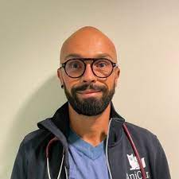
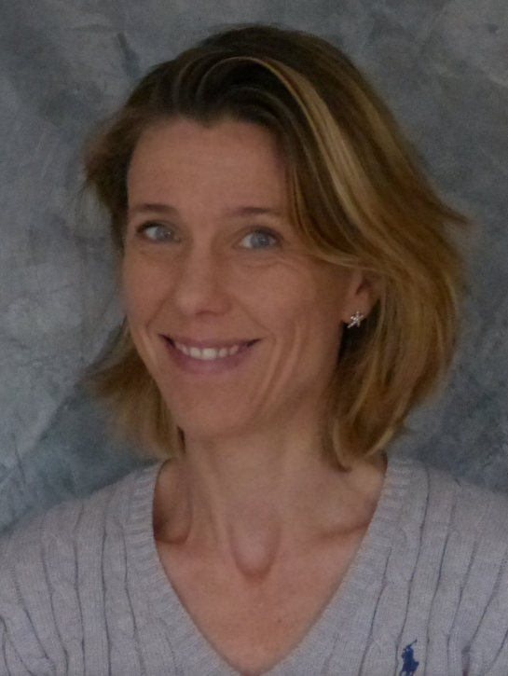
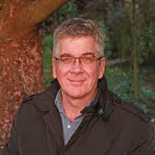
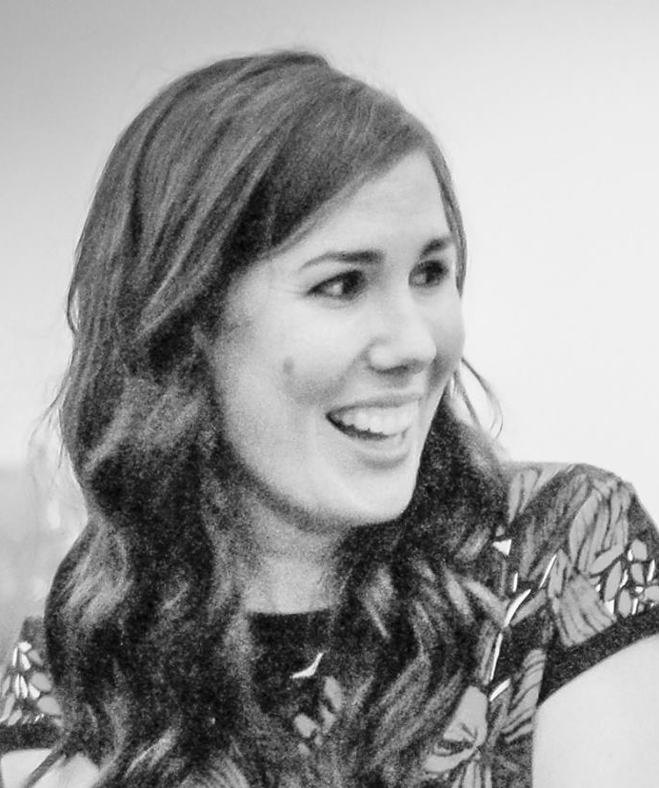
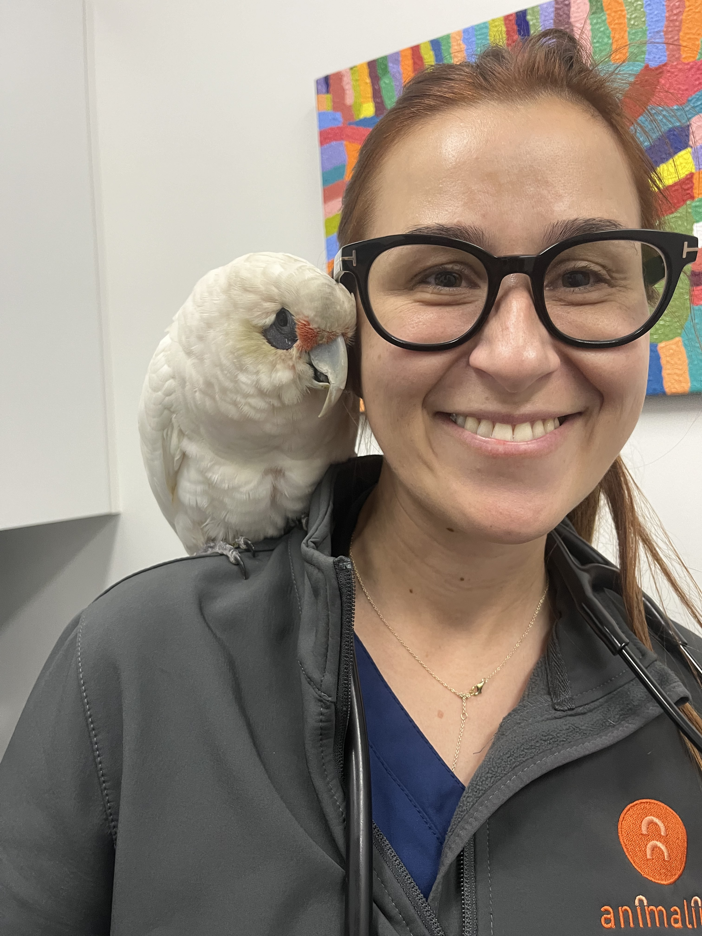
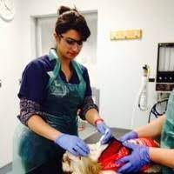
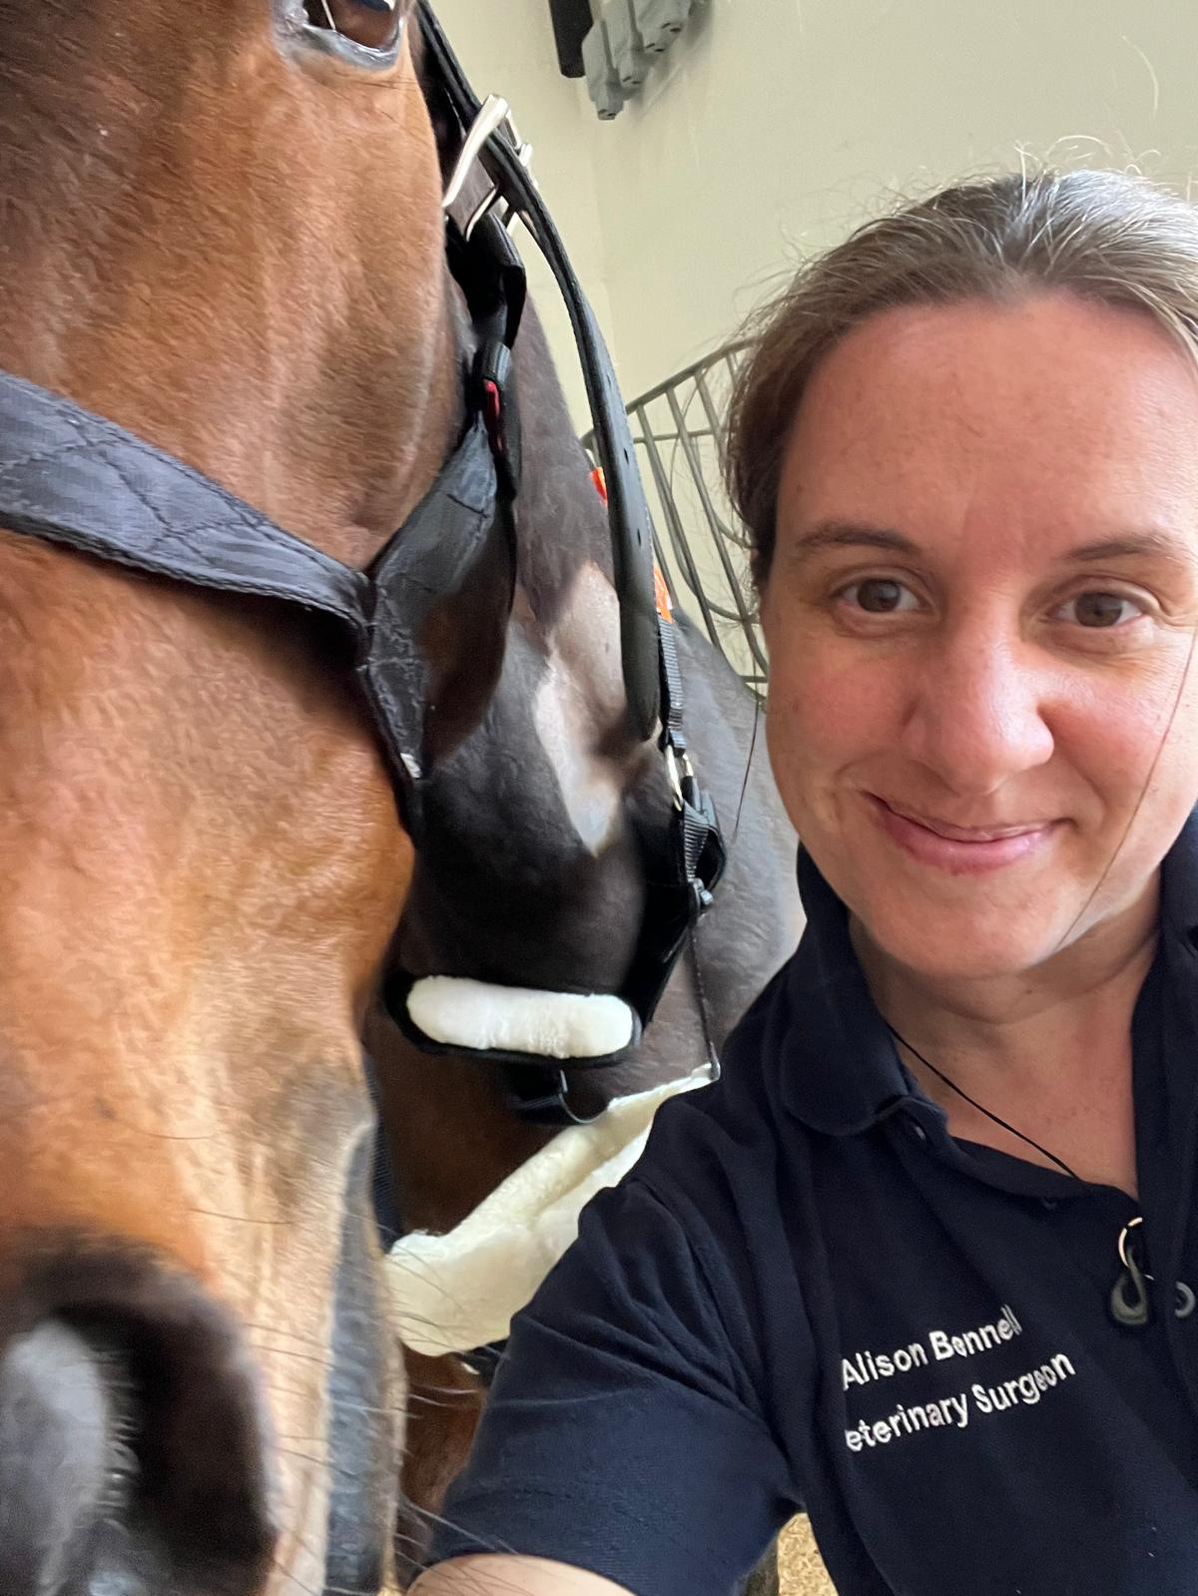
Meet the Trustees
President: Louise Clark
Junior Vice President: Ioannis Savvas
Senior Vice President: Mathieu Raillard
Honorary Secretary: Latifa Khenissi
Membership Secretary: Katherine Robson
Honorary Treasurer: Nicole Studer
Technician Representative: Anja Styhm
General Members: Alison Bennell, Fergus Coutts, Karine Portier
AND
Webmaster: Tim Elliott
VAA Editor in Chief: Daniel Pang
NAVAS representative: Tasha Bartel

Slide 3
  New members
  VAA Editorial Report
  Project update
  Call for new Trustees
  Treasurer’s Report
  AVA Foundation Report

Slide 4

Welcome to our new AVA members!
602 AVA members
249 ECVAA Diplomates
186 Standard Members
84 Intern/Resident Members
47 Nurse/Technician Member
18 Honorary Members
8 Retired Members
9 NAVAS Affiliate Members
LMIC members
  30% discount 3 members
  70% discount 1 member
For ECVAA Diplomates membership - now collected with ECVAA fees
in accordance with their Constitution

Slide 5
Welcome to our new AVA members!
New members since the December 2025 AGM:
Alessandro Sinosis
Jake Burlace
Jesse Gosker
Javier Benito
Pedro Caetanotomas
Jana Flyps
Andres Naula Vajzquez
Vanessa Rupp
Kavya Katta
Jo Fogh
Chris Blignaut
Ele Palmer
Rasmus Fjord Hoegh
Pinja Hietanen
Shauna Feldsher
Jean Clement Bernard
Bruna Hech
Patrick Burns
Jesus Niclo Moreno
Alice Stevens
Stephan Fouad
Katerina Pavlidou
Anna Kurtscheidt
Tom Burger
Pavla Koulova
Latif Emrah Yanmaz
Virginia Papageorgiou
Beatriz Gander Soares
Anna Jonasson Winterberg
Anna Elise Lund
Yu On Yeung
Simona Nagreckiene
Angela Barbaro
Zi Yan Tan

Slide 6
  New members
  VAA Editorial Report
  Project update
  Call for new Trustees
  Treasurer’s Report
  AVA Foundation Report

Slide 7
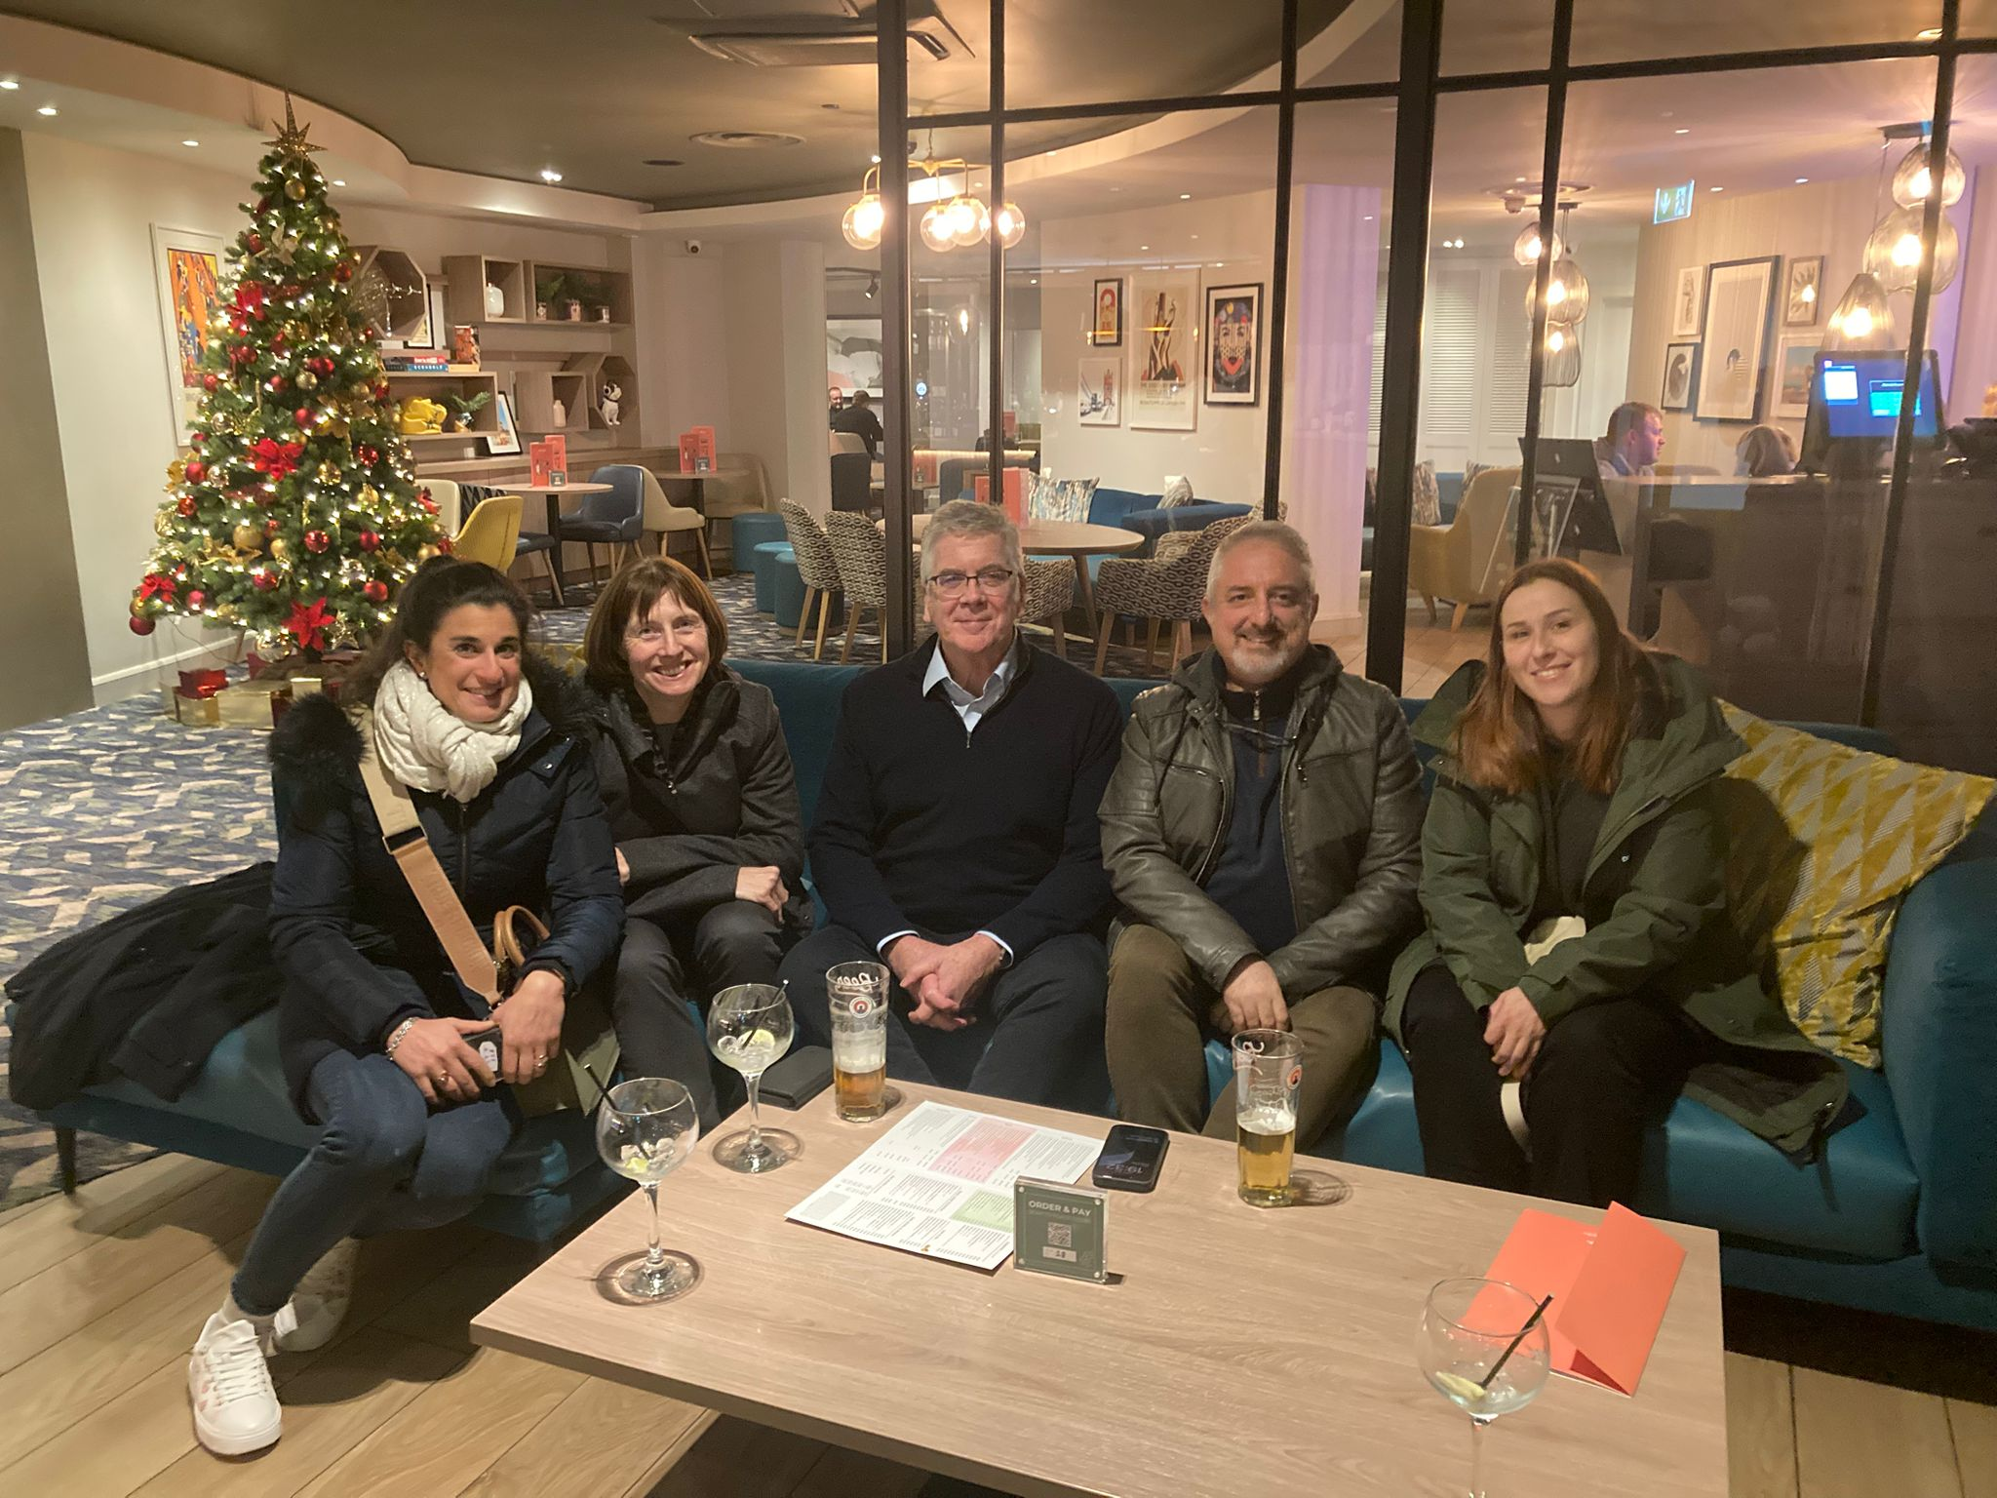
Trustee Retreat (strategy meeting) after LVS
Reflecting on past year
Working on "Strategy" now that "Structure" is in place
Collaboration, liaison and outreach
Improving the impact of the work that the AVA does....

Slide 8
Project update
Veterinary Green Theatre checklist launched at WCVAA
Anaesthetic records with multiple translations
Patient Adverse Event Reporting System (SAFER)
BVNA learning pathway
SAQ challenge
Ethical Review group
RAAN launched in Vienna
AVA podcast
CPD Stream at London Vet Show planned for 2026
Membership fee discount for low and middle-income countries created

Slide 9
Project update
MORE detail on the following on the AVA website or by contacting us:
BVNA learning pathway
SAQ challenge
Ethical Review group
AVA podcast
Membership fee discount for low and middle-income countries

Slide 10


Veterinary Green Theatre Checklist
2
The Veterinary Green Theatre Checklist is an AVA-led, cross-specialism collaboration to create a list of 20 recommendations to reduce the environmental impact of veterinary operating theatres when preparing for surgery, using pharmaceuticals, during surgery, and after surgery.

Slide 11

AVA Anaesthetic Records and Translations
Need to update and to appreciate diverse nature of AVA community
Sponsored but no involvement in content
Have Creative Commons Licence applied to them - for free distribution
Not behind the payment wall of the website
HUGE thanks to AVA members who have contributed to:
  Initial English version
  Providing the text for translation
  Proof-reading the final documents
  Being so collaborative……

Slide 12

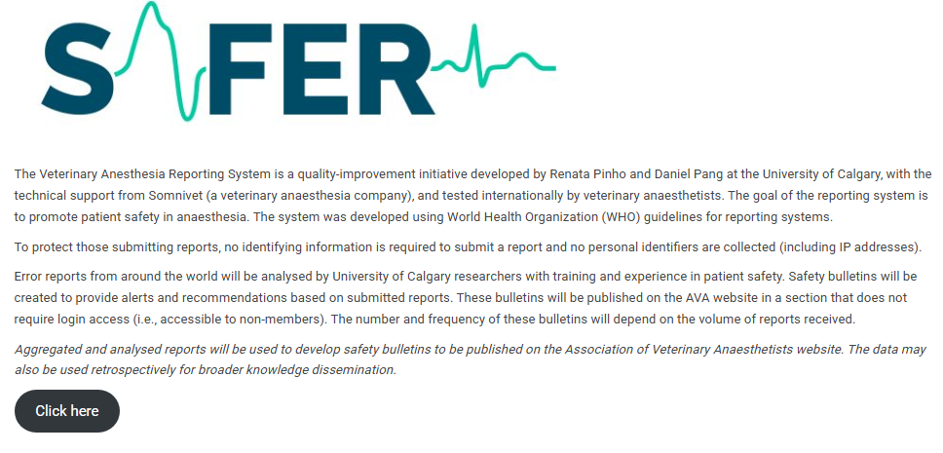
Veterinary Anaesthesia Reporting System

Slide 13
RAAN
(Research Animal Anaesthesia Network)
A subcommittee of the AVA; supporting the AVA’s values & mission

Slide 14
Objectives
build a community of veterinarians interested in experimental refinement through anaesthesia and analgesia;
host a discussion forum and mailing list for network members, to share ideas, experience and information related to veterinary anaesthesia and analgesia in a research context;
foster collaboration between experienced laboratory animal anaesthetists and scientists requiring assistance or advice in animal anaesthesia and analgesia;
facilitate multi-centre research.
Notes:
Reminder

Slide 15
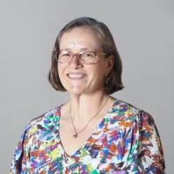
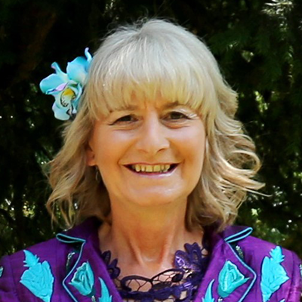
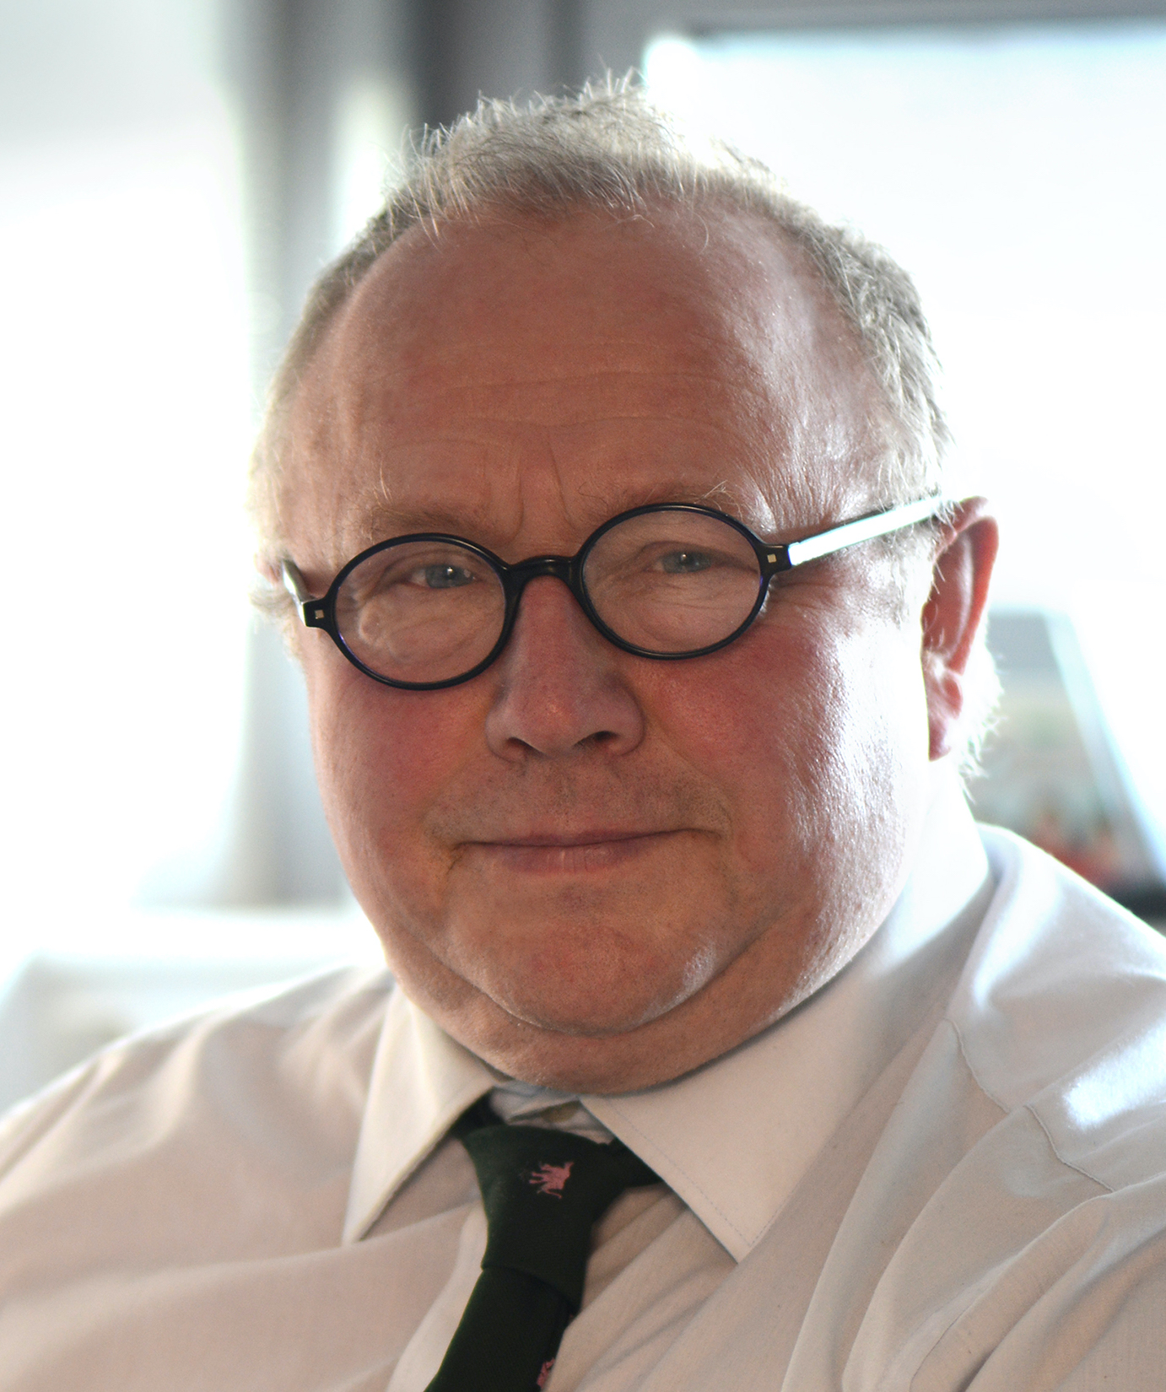
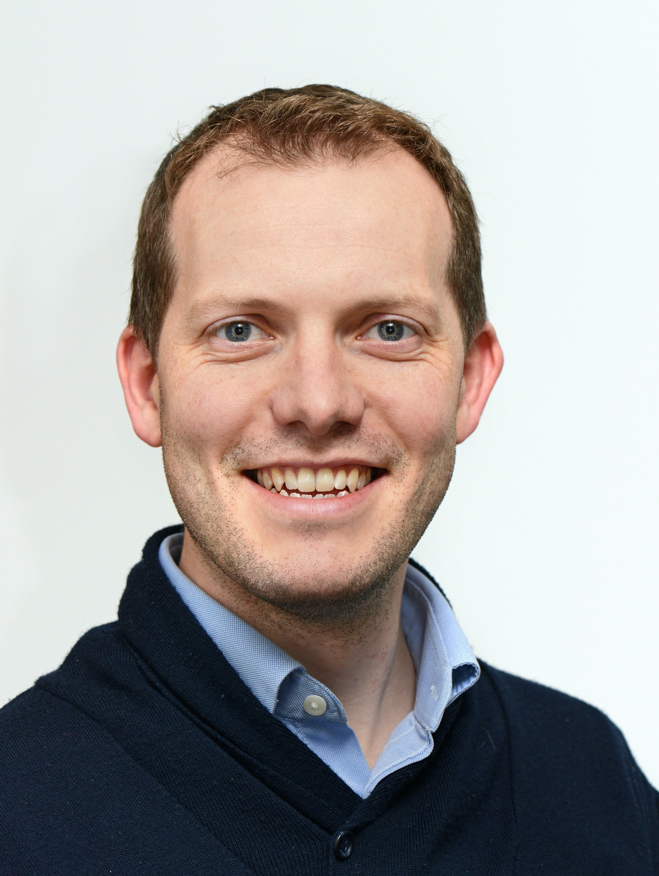
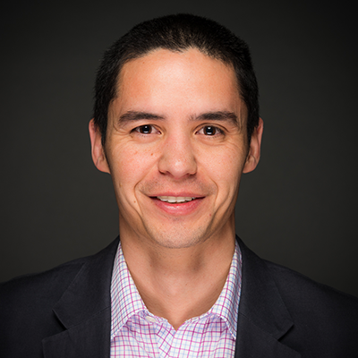
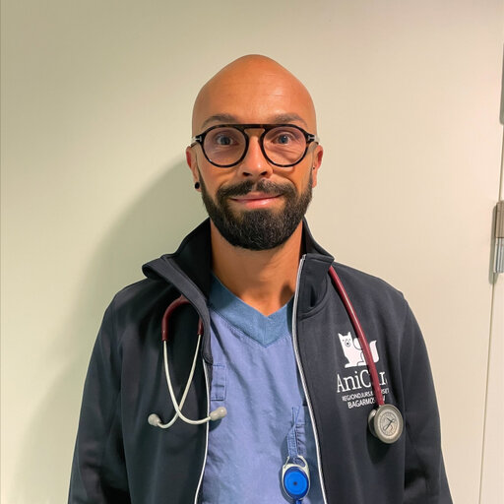
Structure
Executive Committee
Gabby Musk | Polly Taylor | Eddie Clutton | Stephen Greenhalgh | Daniel Pang | Mathieu Raillard
Members
Currently 75 (increased from 52 in May 2025)
Notes:
Membership increased by almost 50%

Slide 16
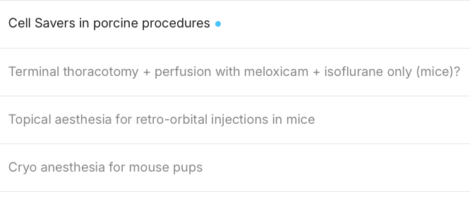

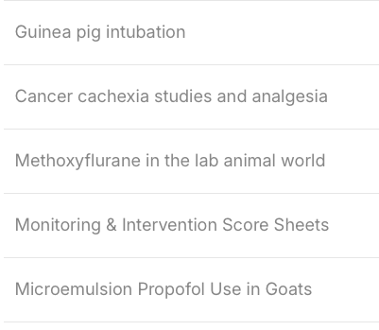
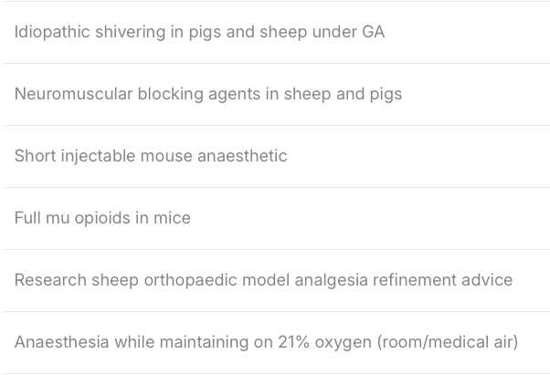
This year’s activities…
28 new topics in the last year
Notes:
Discourse topics in past year

Slide 17

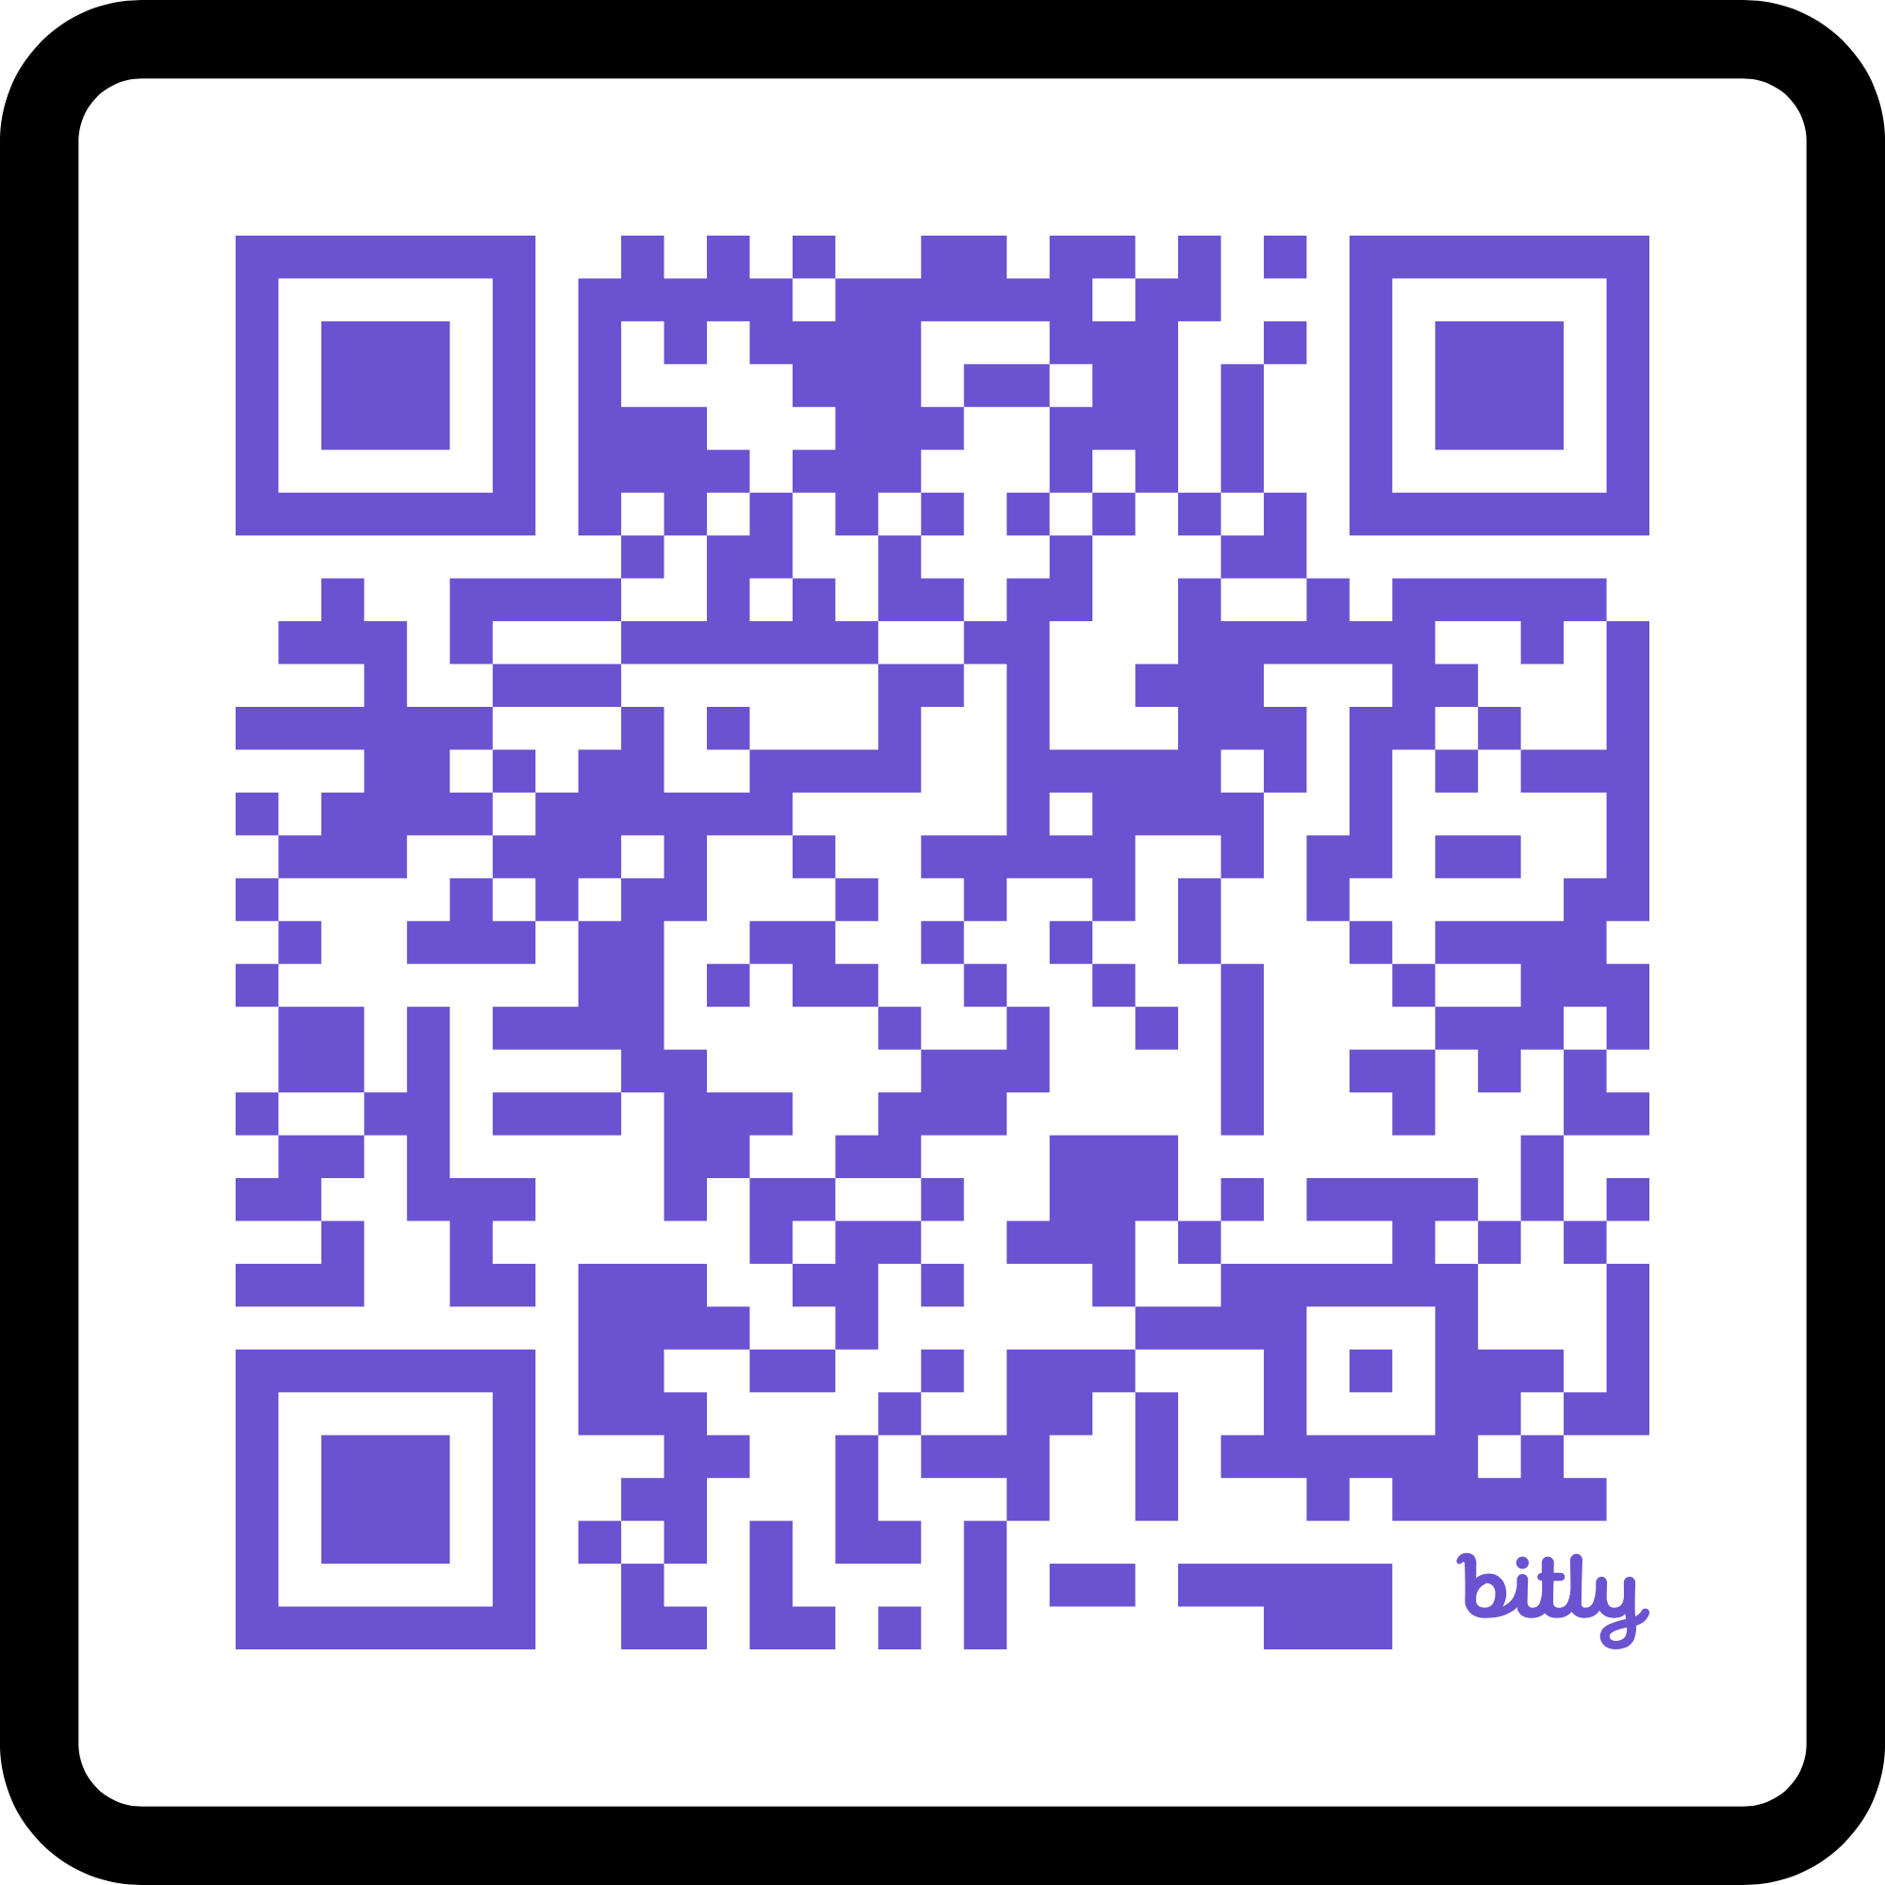
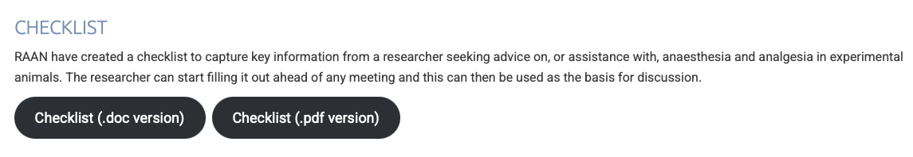
This year’s activities…
Notes:
Podcast (incl QR code to link to this directly)
Checklist on AVA Website
[Also publicised at various conferences: WCVA and RCoA etc]

Slide 18
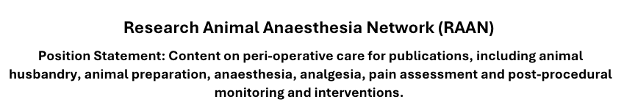


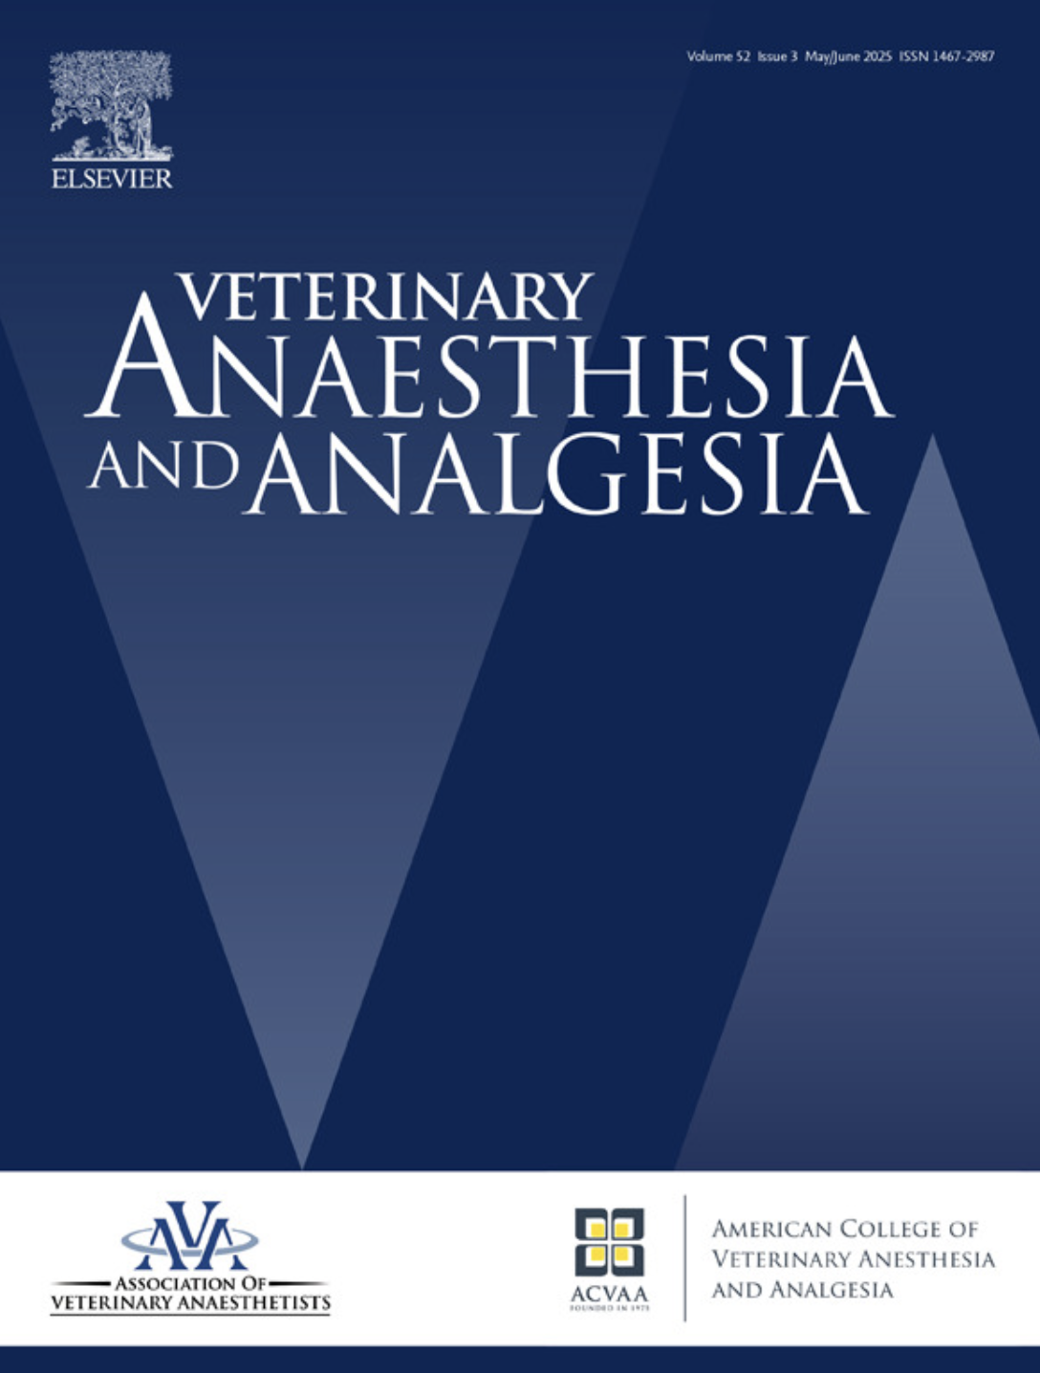

Next steps…
Notes:
Growth / Engagement
NC3Rs webinars x2 – June 2026
ANZCVS – July 2026
Position statement on reporting – imminent
VAA editorial

Slide 19
Thanks
AVA Trustees
Louise Clark
Mathieu Raillard
Ioannis Savvas
Karine Portier
Tim Elliott
Notes:
Would not be possible without the support of…

Slide 20

Get Involved!
ResAnAnNet@gmail.com
Notes:
AVA website address
Qrcode
Email address

Slide 21

London Vet Show
Call out for ideas at AGM:
“Anaesthesia and the Geriatric Patient”
Thursday morning stream (5 lectures)

Slide 22
CEPEF report
New relationship between relationship between AVA and CEPEF CIC

Slide 23

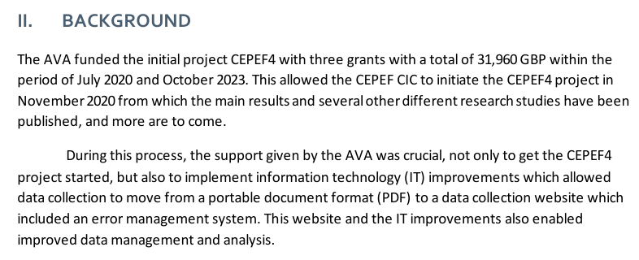
Notes:
Would not be possible without the support of…

Slide 24

CEPEF CIC
What is a CIC?
CICs are limited companies which operate to provide a benefit to the community they serve. The purpose of a CIC is primarily one of community benefit rather than private profit. GOV.UK
CEPEF CIC was set up to be independent from any of the several institutions in which the CEPEF team members were associated/employed.

Slide 25
Report from CEPEF CIC to the AVA; Liverpool, May 2026
Confidential Enquiry into Perioperative Equine Fatalities
Community Interest Company
Background
CEPEF began in 1999, Mark Johnston’s PhD
CEPEF2, 2002;
healthy horses, 0.9% death within 7 days of GA
CEPEF4 began data collection in 2020
CEPEF4 VAA 2025: 0.6% death within 7 days anaesthesia
CEPEF4 also evaluated standing sedation; lower mortality but not zero

Slide 26
CEPEF4
Data analysis:
Standing sedation 12307 horses,
presented at WCVA Paris, in press EVJ
Intraoperative complications
presented at WCVA Paris, under review EVJ
Interobserver agreement of death classification,
presented at WCVA Paris, under review BMCvr
Morbidity data presented at WCVA Paris & BEVA congress 2025
manuscript in preparation
NON COLIC and COLIC data under analysis
manuscripts in preparation
Other analyses to follow

Slide 27
CEPEF5
Building on lessons learned from CEPEF4:
Refining questionnaire
aiming to ask prospective questions
Website
new version almost complete
Test runs of CEPEF5 planned before launch
making the most of the web system
avoiding/learning from mistakes made in CPEF4

Slide 28
CEPEF CIC
Dissemination of results
Numerous presentations worldwide
AVA support always acknowledged
Kate Borer-Weir Memorial Fund for the initiation of the work
AVA Foundation for support of the IT improvements

Slide 29
Publications
Gozalo-Marcilla M, Redondo JI, Johnston M, Taylor P, Bettschart-Wolfensberger R. CEPEF4: update and plan. Vet Anaesth Analg. 2020 Sep;47(5):724-725. doi: 10.1016/j.vaa.2020.08.004.
Gozalo-Marcilla M, Redondo JI, Johnston M, Taylor P, Bettschart-Wolfensberger R. A new equine anaesthetic mortality study two decades after CEPEF2: CEPEF4 is going live! Equine Vet J. 2020 Nov;52(6):891-892. doi: 10.1111/evj.13327.
Gozalo-Marcilla M, Bettschart-Wolfensberger R, Johnston M, Taylor PM, Redondo JI. Data Collection for the Fourth Multicentre Confidential Enquiry into Perioperative Equine Fatalities (CEPEF4) Study: New Technology and Preliminary Results. Animals (Basel). 2021 Aug 30;11(9):2549. doi: 10.3390/ani11092549.
Loomes K, de Grauw J, Gozalo-Marcilla M, Redondo JI, Bettschart-Wolfensberger R. A systematic review of the prevalence of post-operative complications after general anaesthesia in adult horses (2000-2023). Equine Vet J. 2025 Jul;57(4):827-861. doi: 10.1111/evj.14416.
Domenech L, Redondo JI, Taylor PM, Bettschart-Wolfensberger R, Johnston GM, Doménech J, Gozalo-Marcilla M. Error management in large data sets: A critical component of data collection in veterinary medicine. Vet Anaesth Analg. 2025 Sep-Oct;52(5):516-524. doi: 10.1016/j.vaa.2024.11.005.
Gozalo-Marcilla M, Redondo JI, Bettschart-Wolfensberger R, Domenech L, Doménech J, Johnston GM, Taylor PM. The Confidential Enquiry into Perioperative Equine Fatalities: phase 4 (CEPEF4) - a worldwide observational, prospective, multicentre cohort study in 2025. Vet Anaesth Analg. 2025 Sep-Oct;52(5):525-538.
Taylor PM, Gozalo-Marcilla M, Bettschart-Wolfensberger R, Redondo JI, Johnston GM. Sixty years of equine anaesthesia - are we getting better at it? Vet Anaesth Analg. 2025 Nov-Dec;52(6):720-729. doi: 10.1016/j.vaa.2025.04.012.
Boocock H, Flyps J, Escobar A, Redondo JI, Taylor PM, Gozalo-Marcilla M, Johnston GM, Bettschart-Wolfensberger R, Sullivan R. Donkey and Hybrid Anaesthetic Mortality in an Observational, Prospective, Multicentre Cohort Study. Animals (Basel). 2025 Jun 25;15(13):1880. doi: 10.3390/ani15131880.

Slide 30
Report from CEPEF CIC to the AVA
Liverpool, May 2026
Thank you!
Wonderful support from the AVA
All the centres who assiduously collected the data

Slide 31
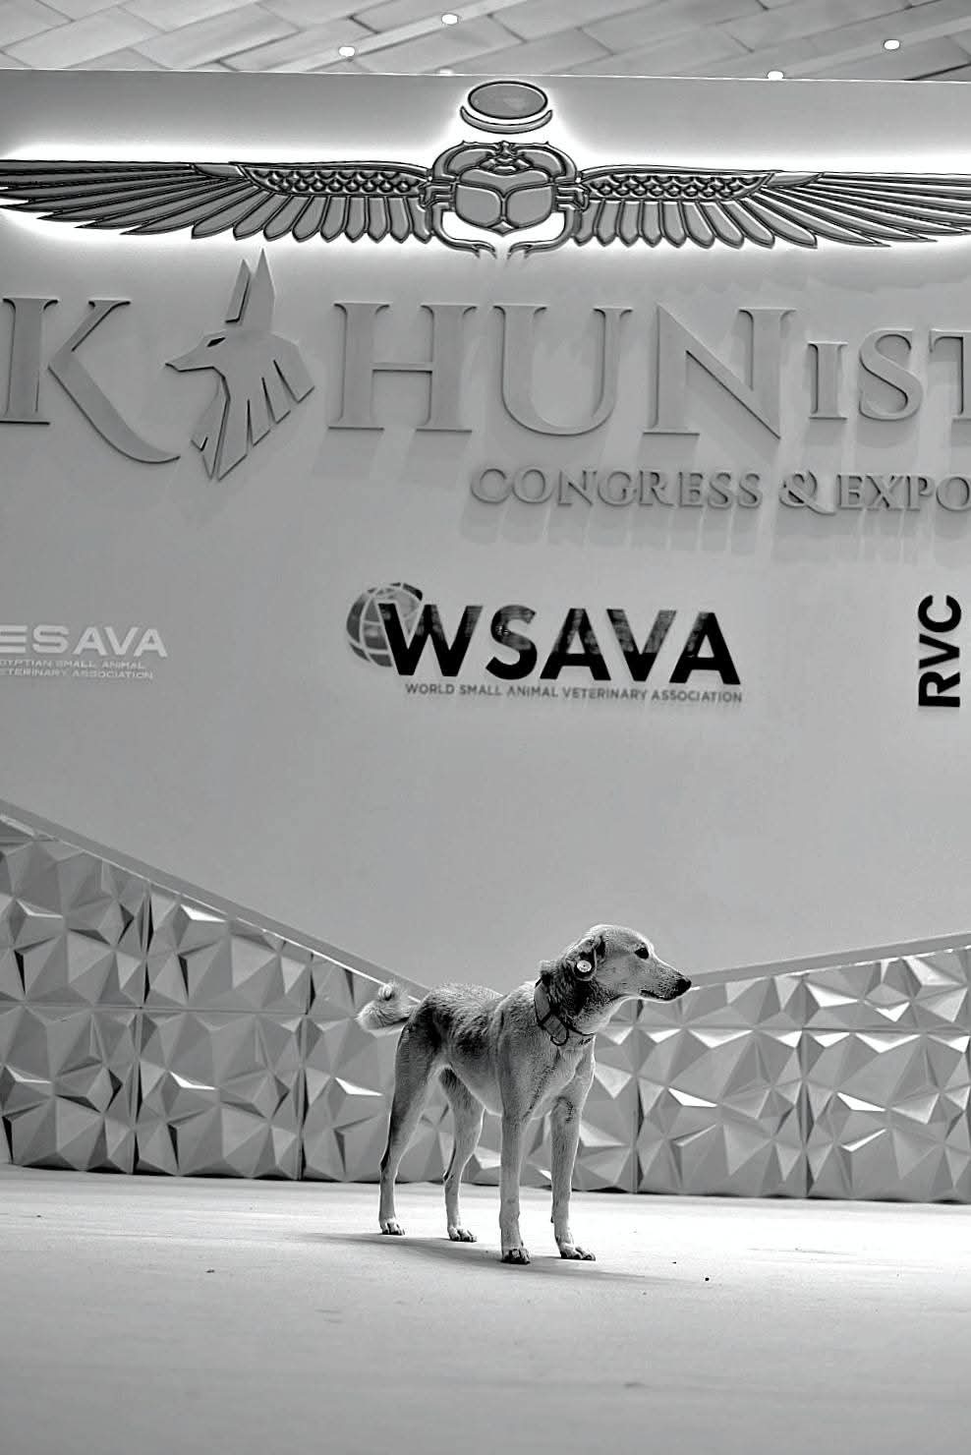
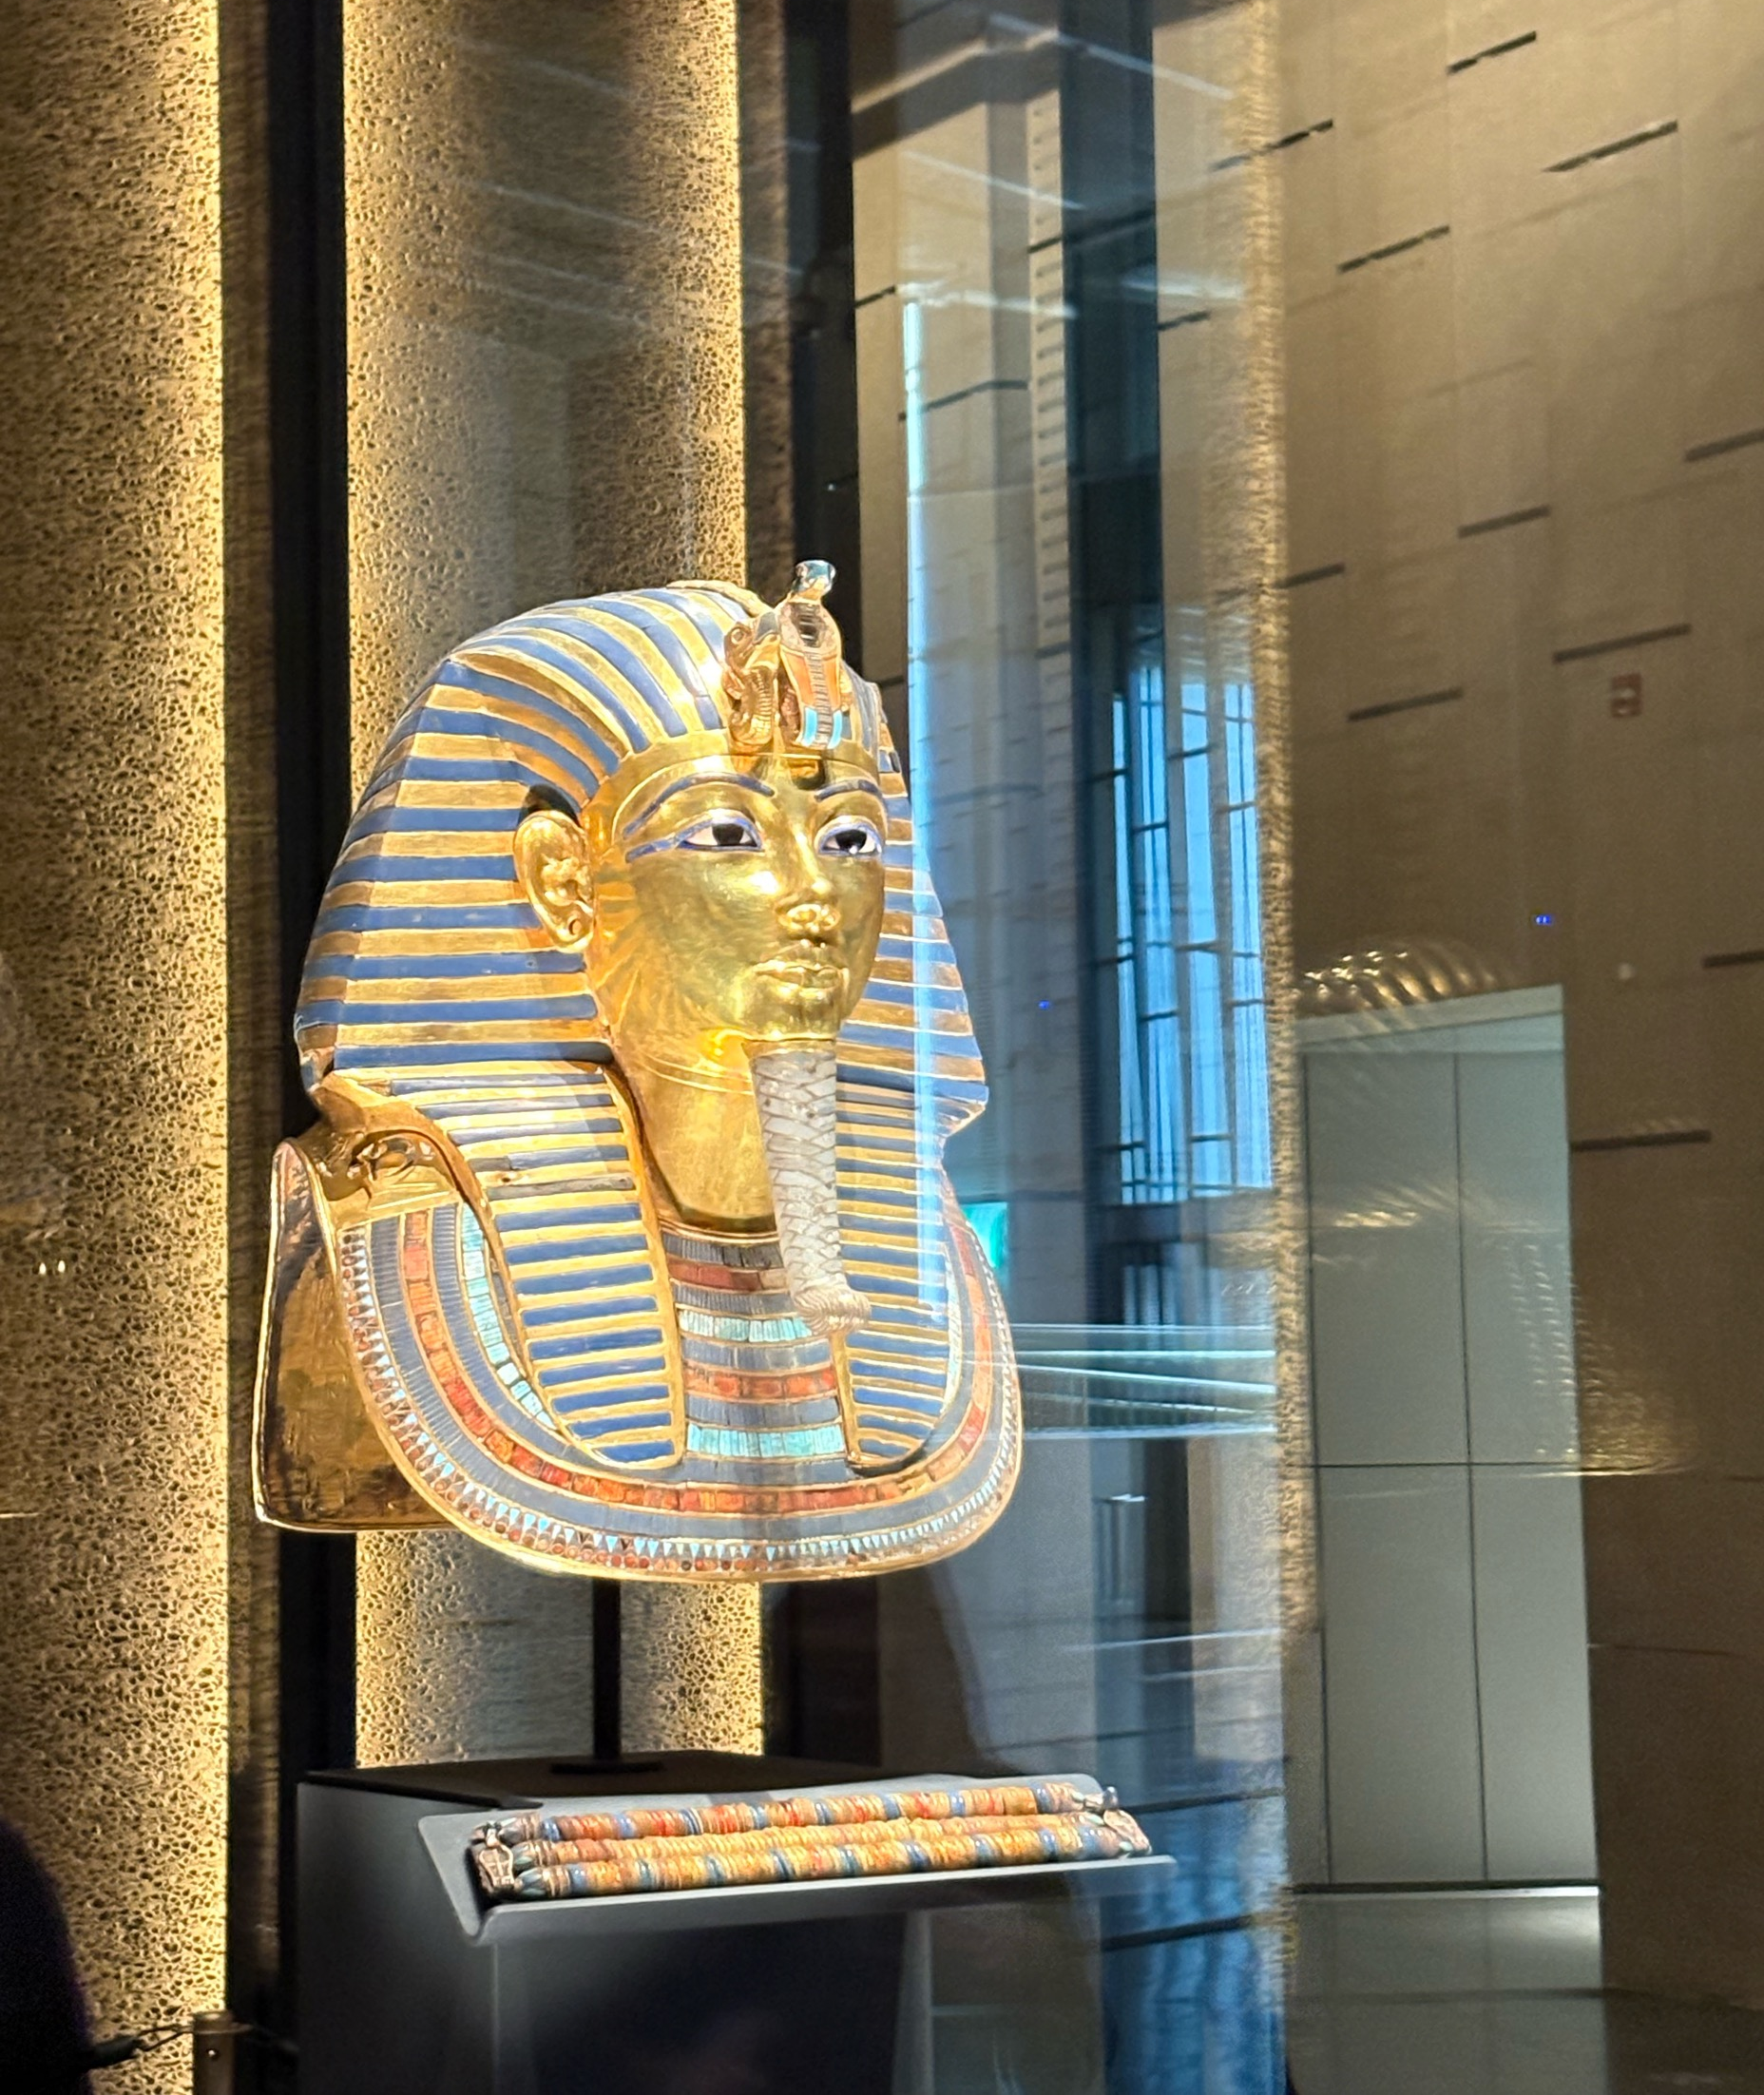
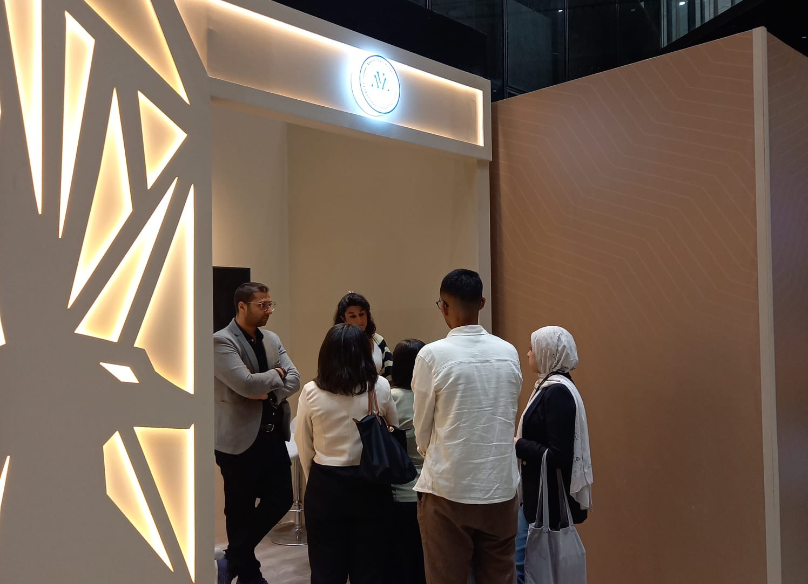
ESAVA Kahun 1st Congress in Cairo
Notes:
We were incredibly fortunate to be invited to Kahun, the first Congress of the Egyptian Small Animal Veterinary Association, held at the magnificent GEM- the Great Egyptian Museum. The organisers kindly offered us a booth, which gave us the opportunity to engage directly with the vet attending the event.Through videos, quizzes, and discussions, we were able to raise awareness of the essential role of anaesthesia and analgesia in successful veterinary practice and in ensuring the welfare of patients which is at the heart of the AVA. The conversations were lively, thoughtful, and full of curiosity — a wonderful reminder of the impact that shared knowledge and collaboration can have.The venue itself added something truly special to this initiative. We learned that both the Great Egyptian Museum and the Giza Plateau — home to the pyramids — are actively involved in safeguarding the welfare of the animals living there, including dogs, camels, and horses. While they recognise that there is still much to be done, they have already put systems in place to provide health checks and treatment for dogs, and they work closely with local vets.This congress was an inspiring starting point for strengthening connections, sharing expertise, and supporting the development of safe, evidence‑based vet practices in Egypt.

Slide 32
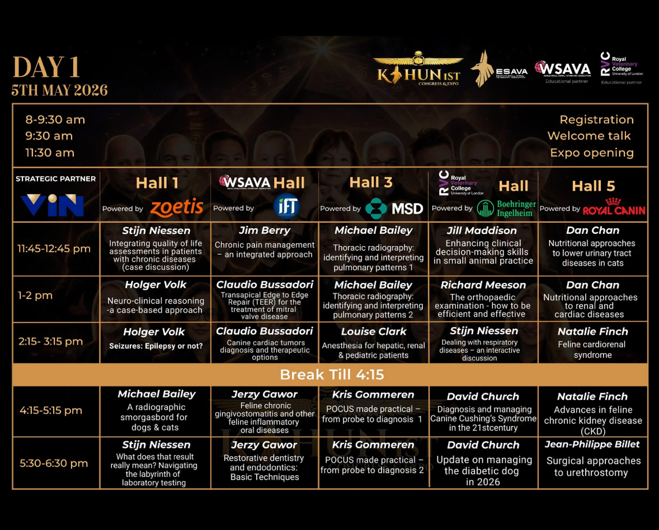
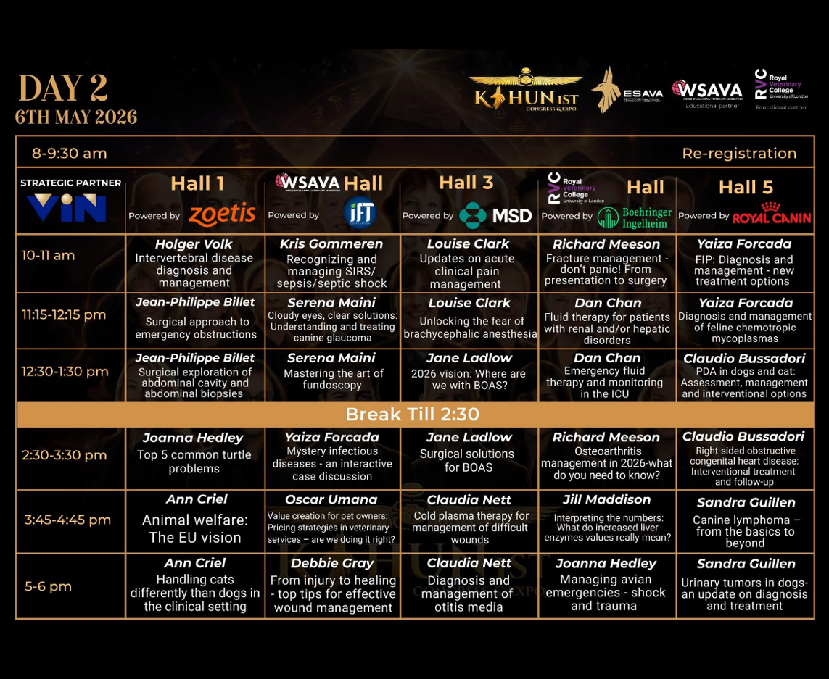
ESAVA Kahun 1st Congress in Cairo
Notes:
The scientific programme was outstanding, with an incredible group of speakers — all internationally recognised experts in their fields. The ESAVA invited the AVA President to deliver several lectures, including sessions on the challenges of brachycephalic anaesthesia, updates in acute pain management, and key anaesthetic considerations for critical patients with hepatic or renal disease, as well as for paediatric patients.These sessions were exceptionally well received.

Slide 33
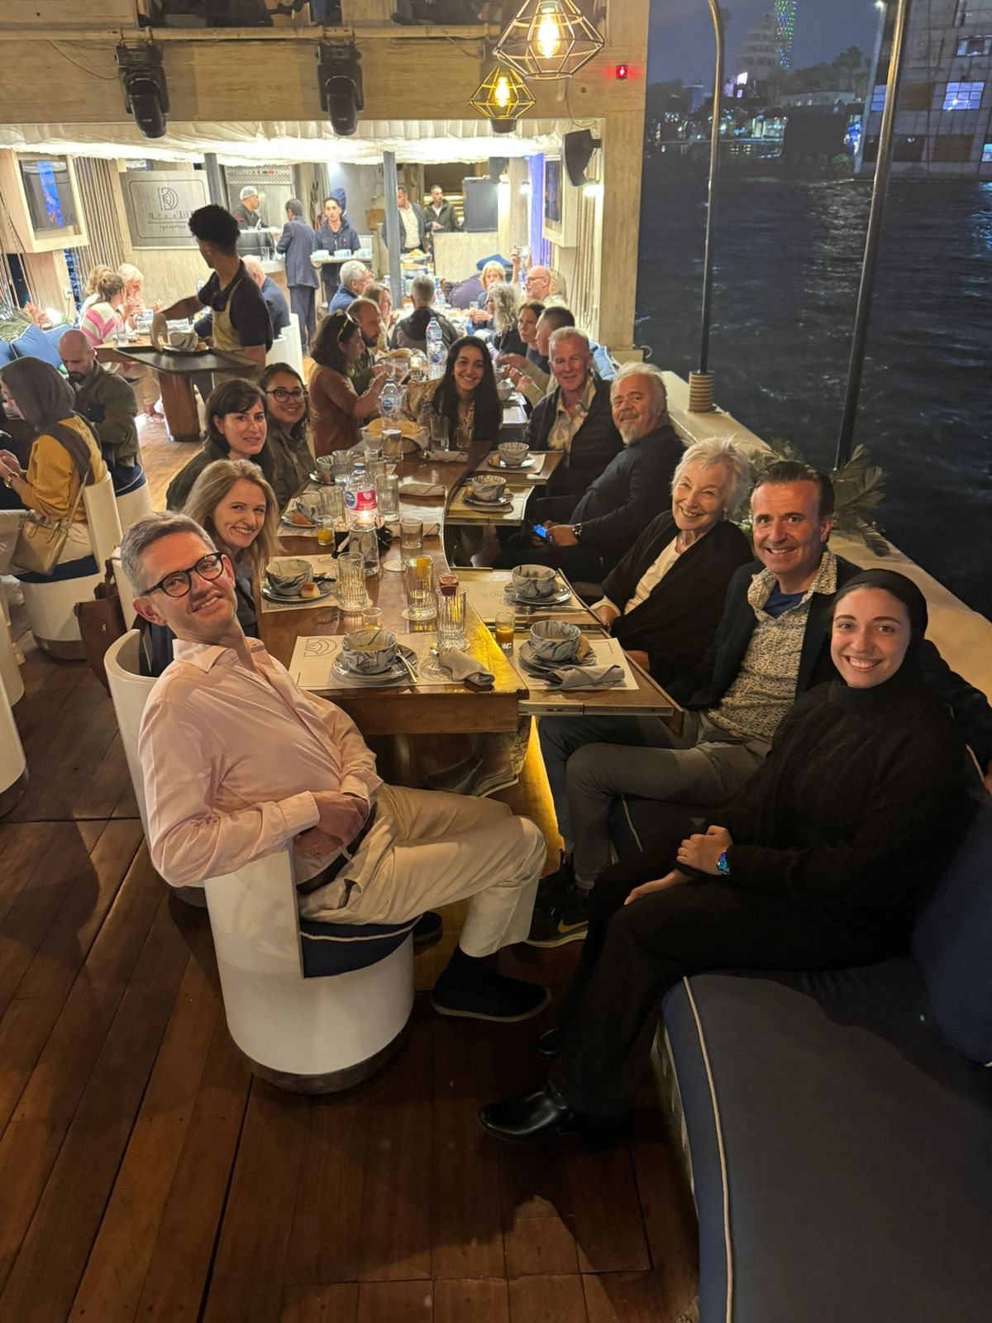
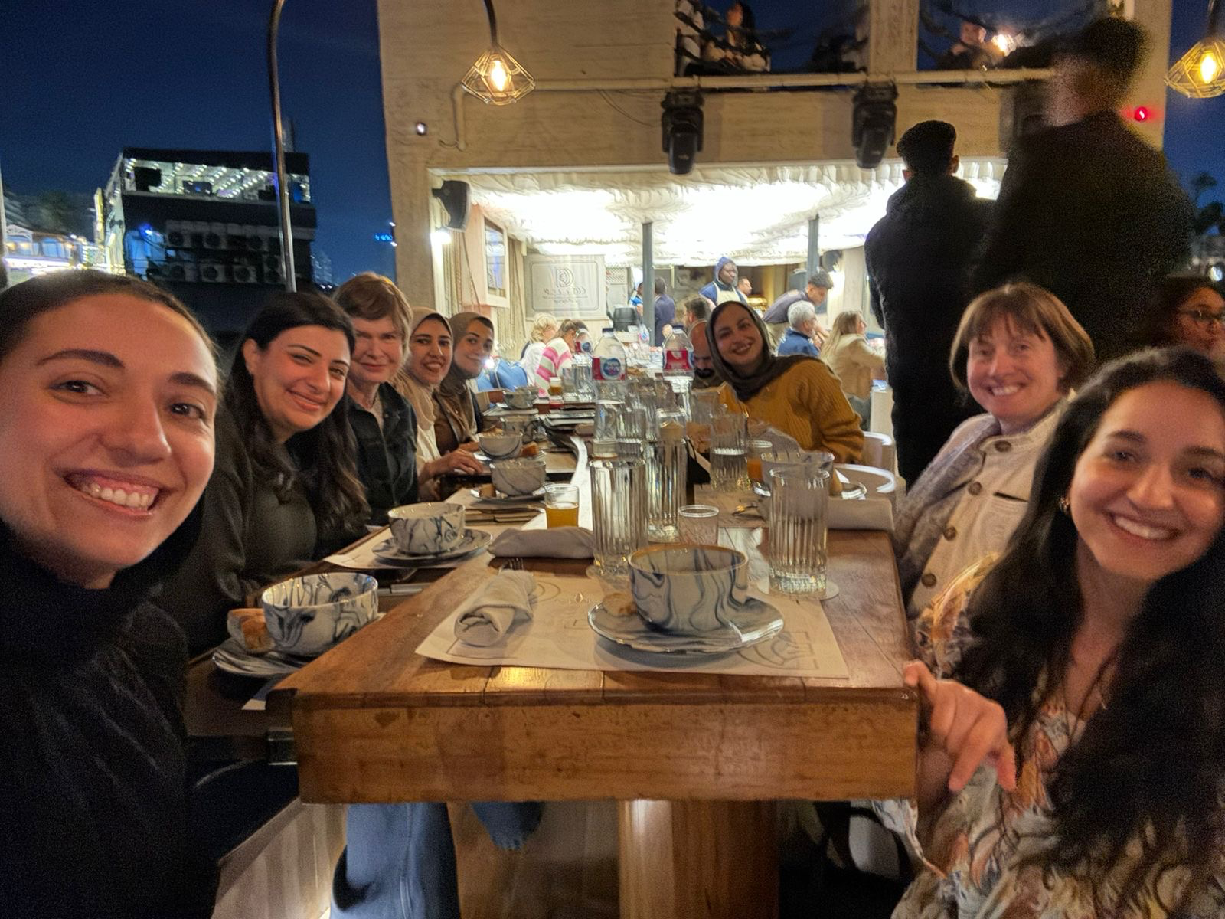
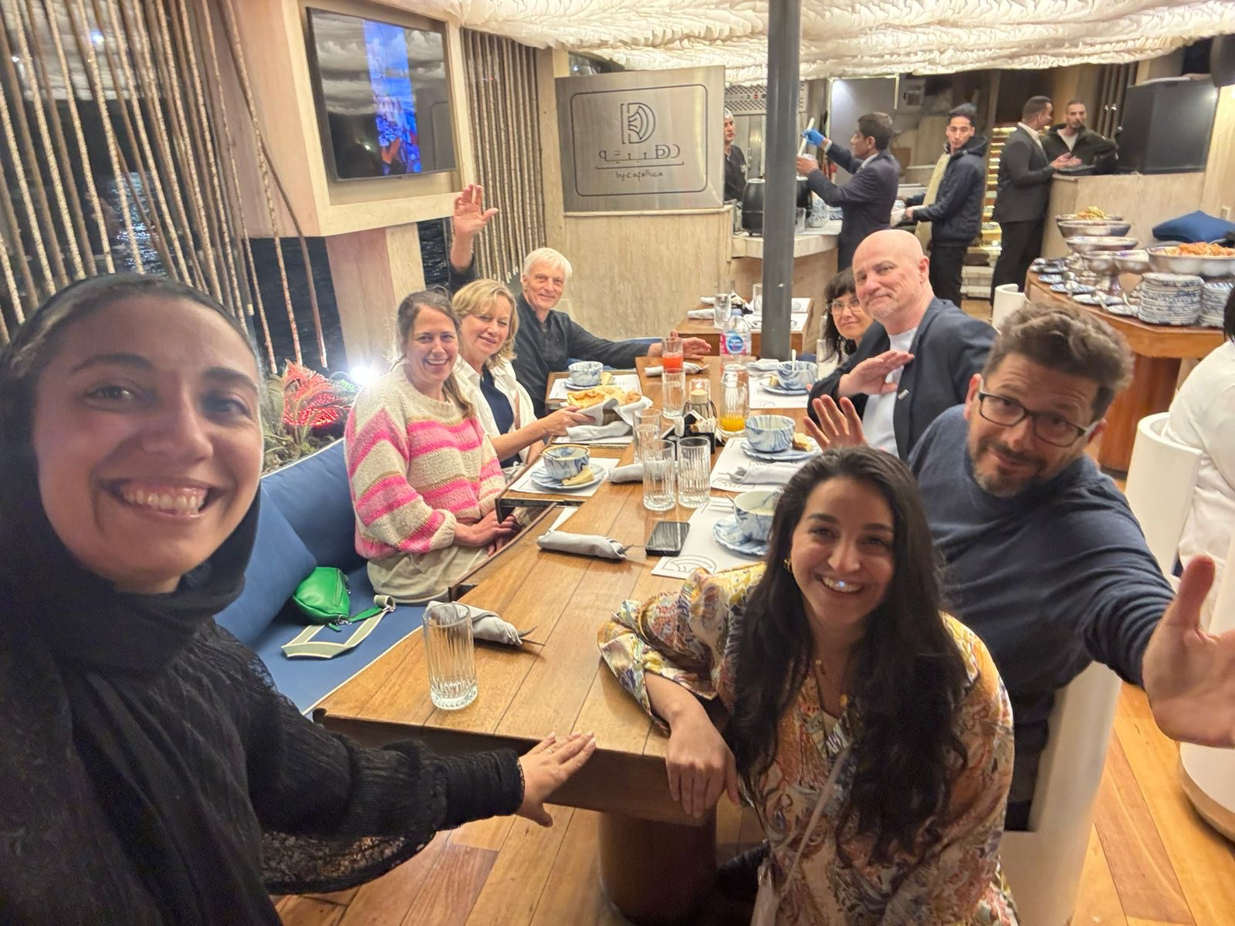
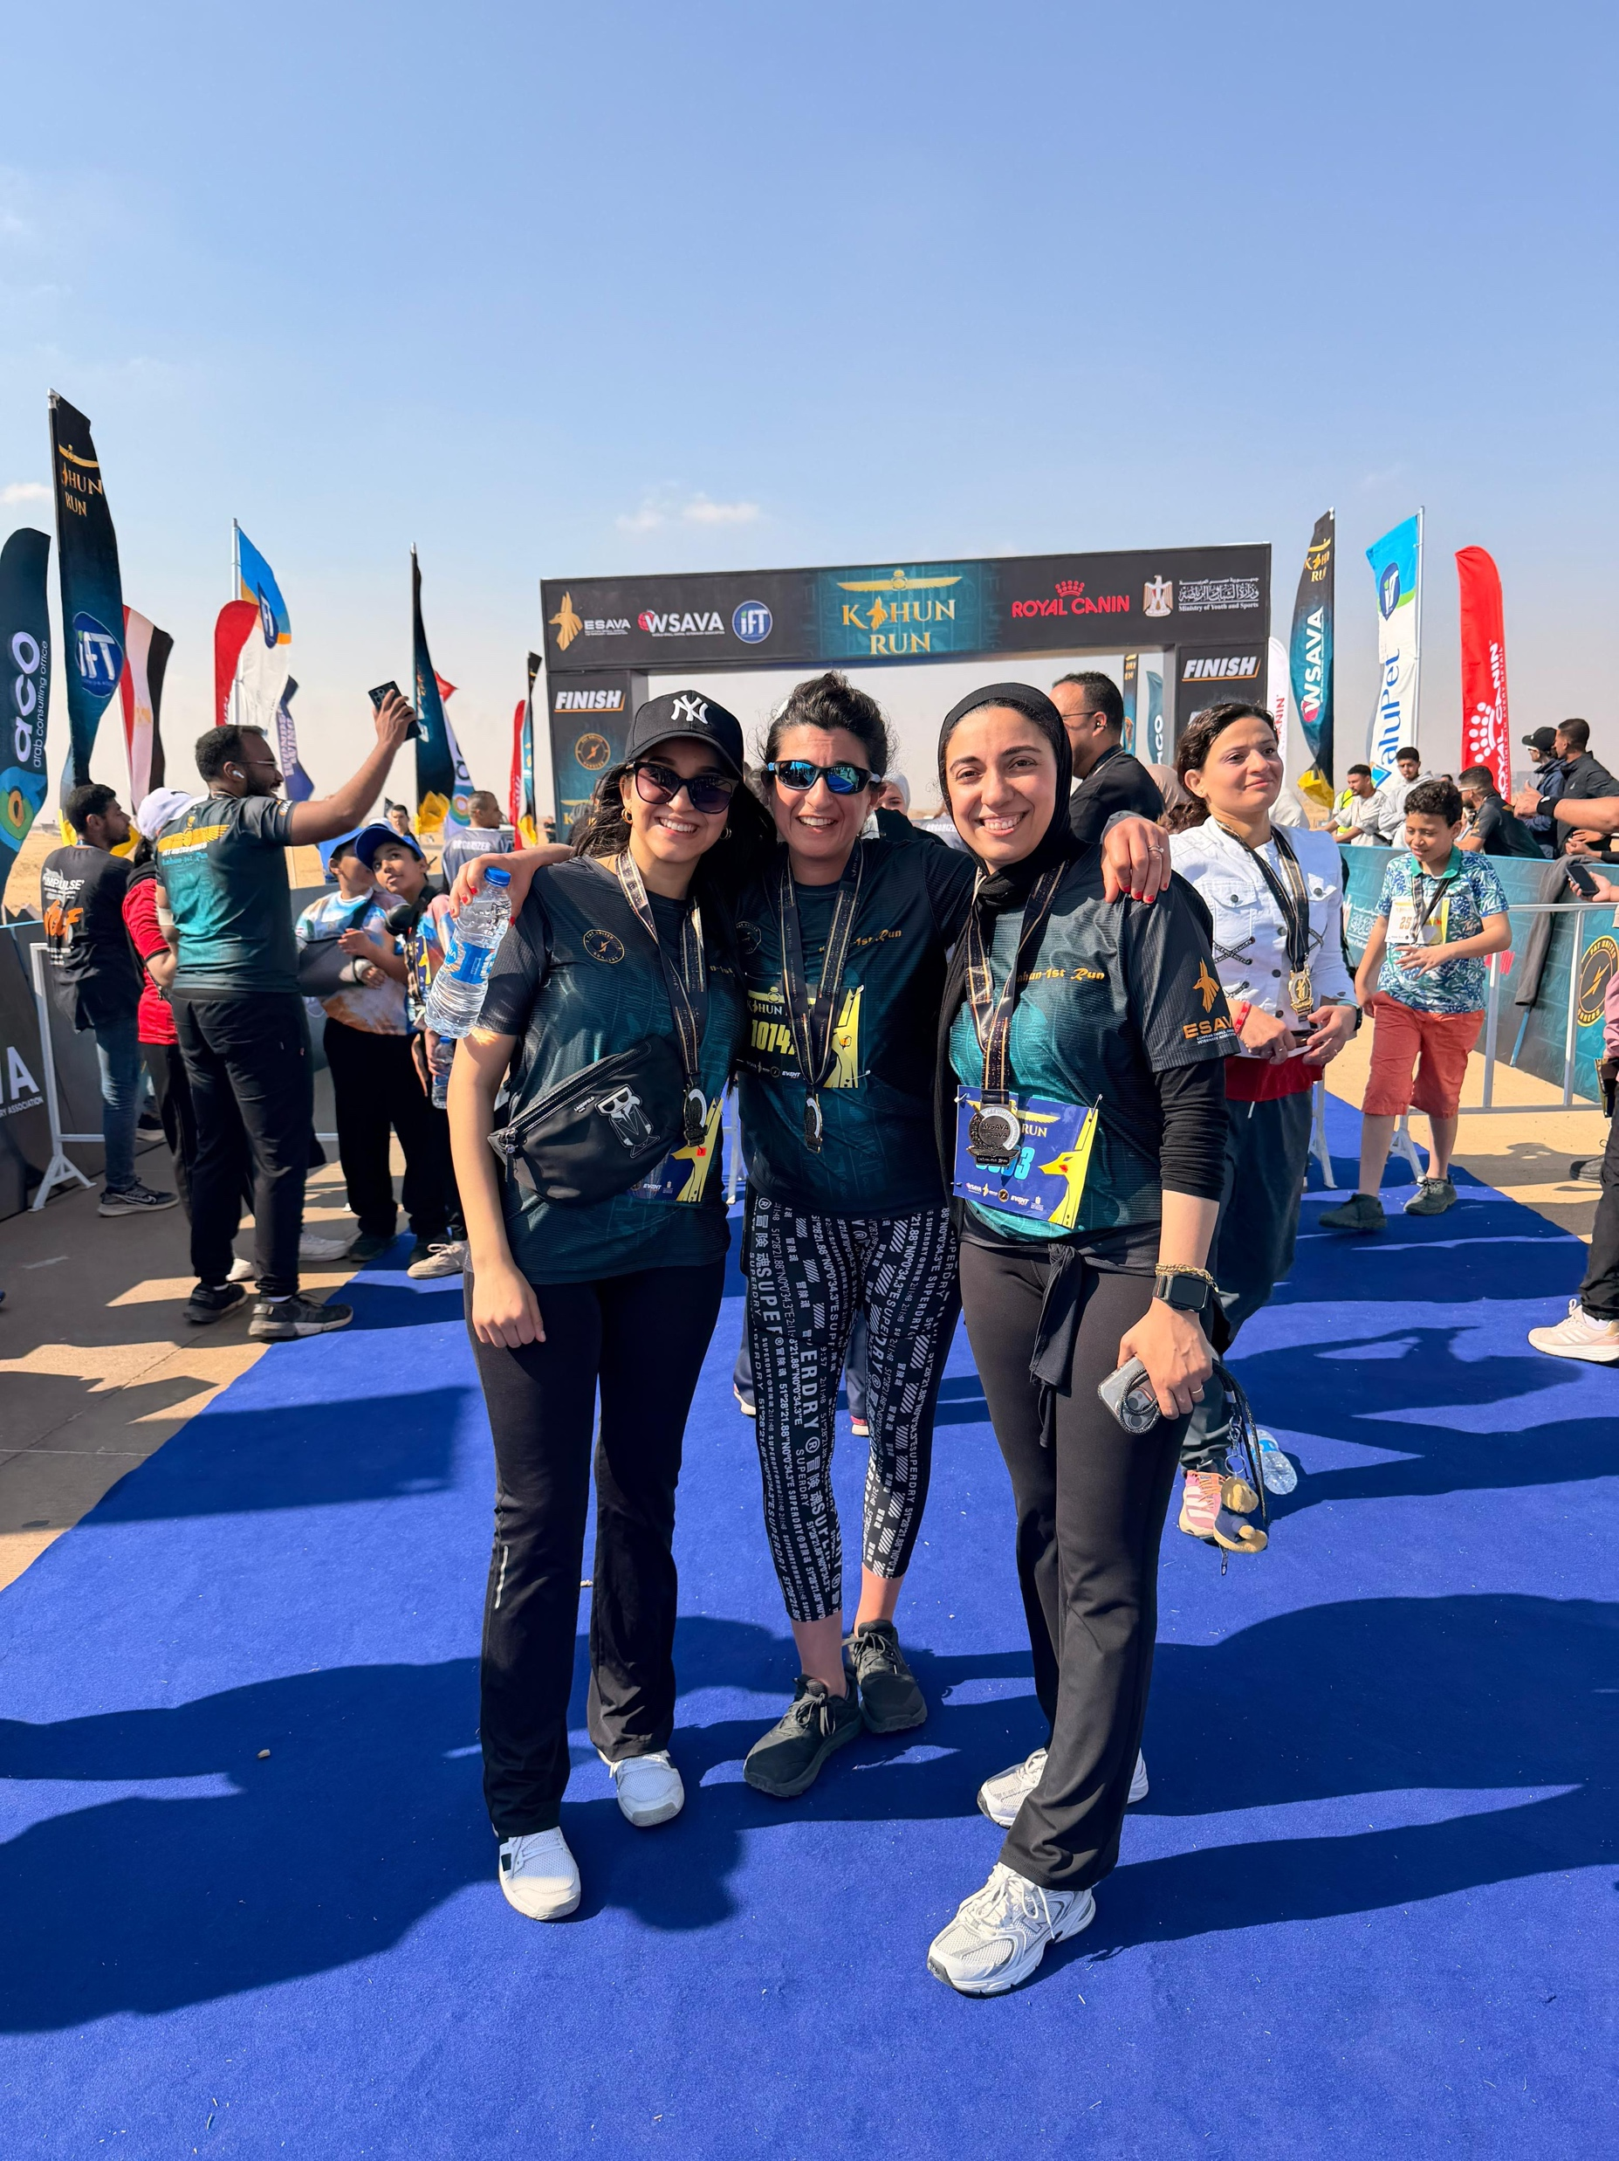
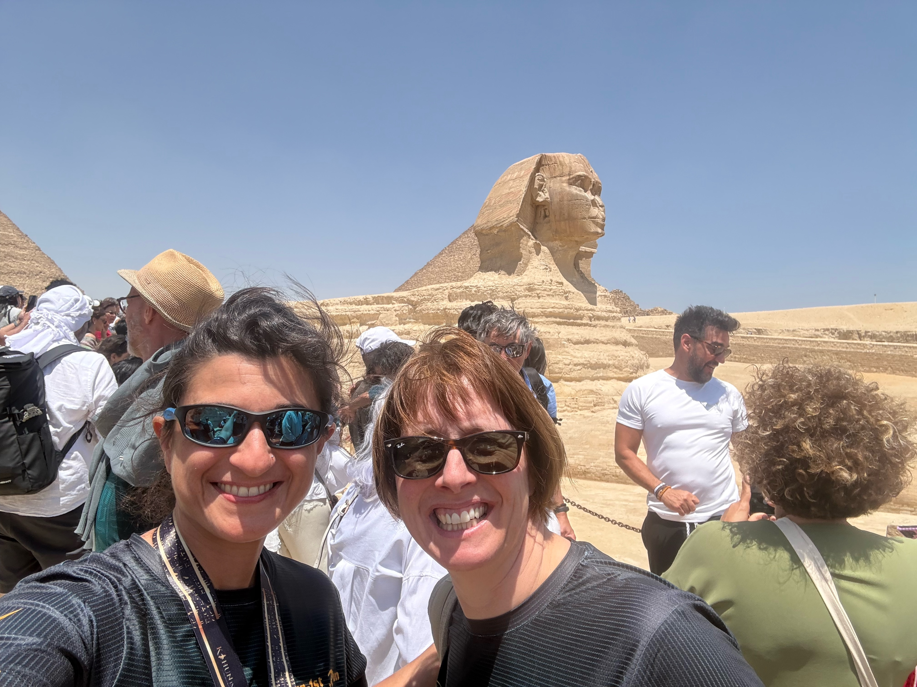
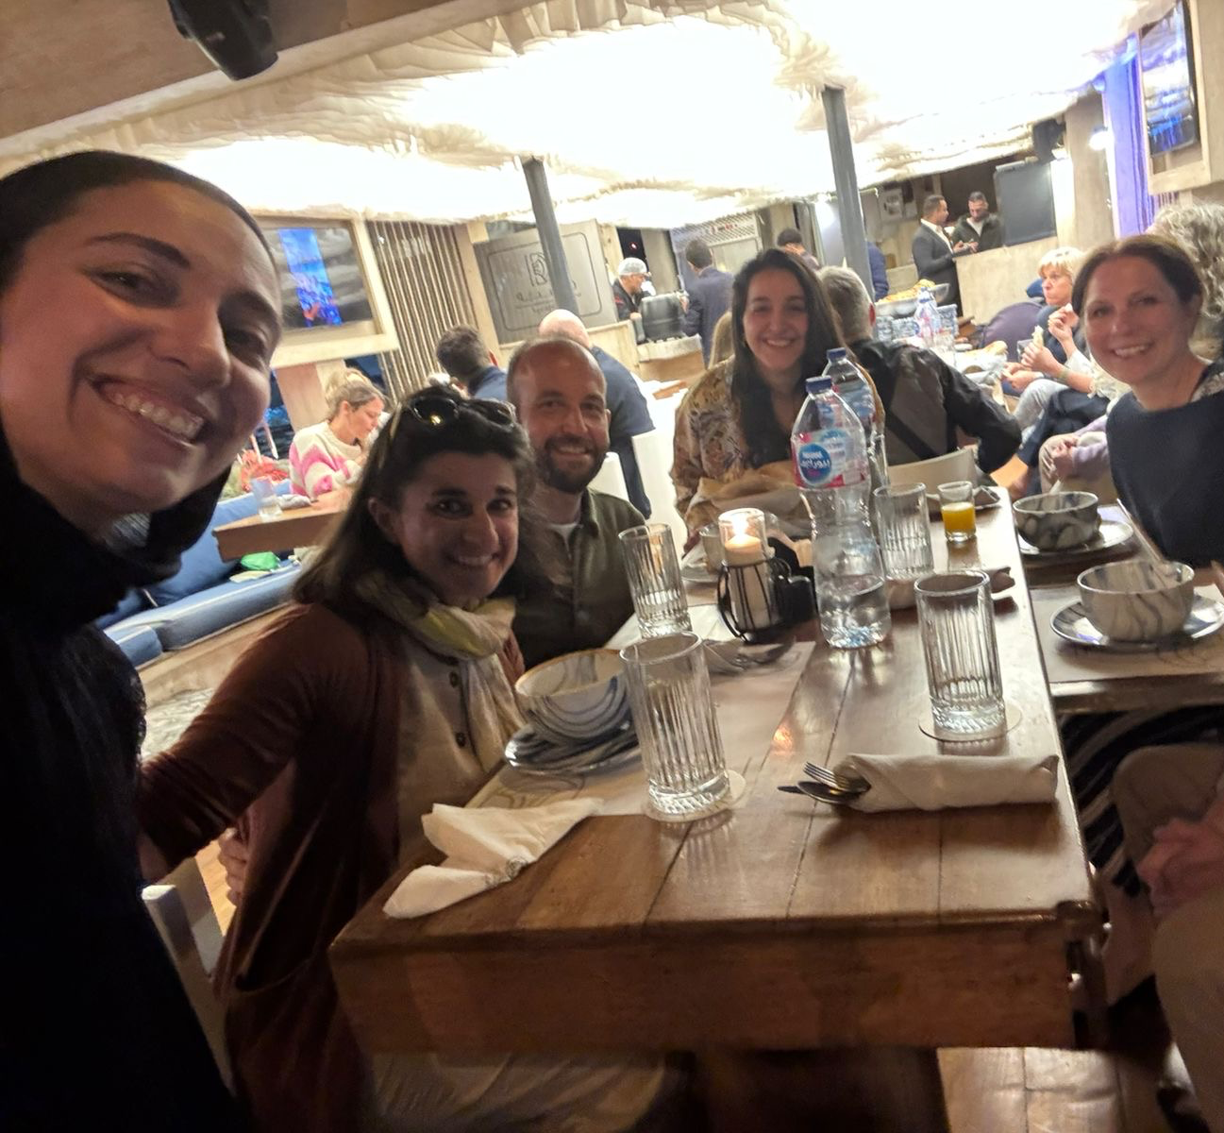
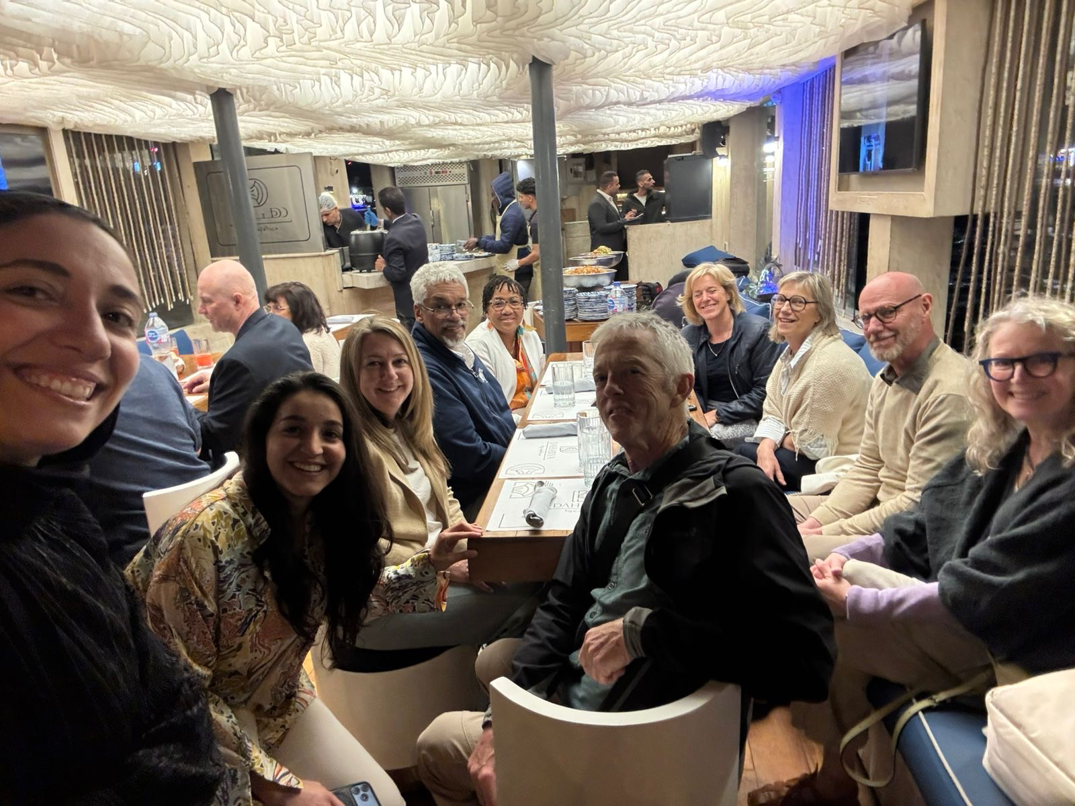
ESAVA Kahun 1st Congress in Cairo
Notes:
The Kahun organising committee showed the speakers and our team truly genuine Egyptian hospitality. We were welcomed as friends, and they offered us remarkaple opportunities to discover their rich culture and history. They made us feel part of a large, supportive family, which encouraged meaningful dialogue between speakers and brought the specialist community a little closer together. Their dedication to hosting and entertaining all the speakers. Created an exceptional atmosphere of inter-speciality networking. This momentum has laid the foundation for even stronger collaboration between veterinary specialities, fostering a spirit of openness and shared purpose that will undoubtedly benefit the profession worldwide. The highlight of this congress was the run organise at the end of the congress around the pyramide on the guizee plateau.

Slide 34

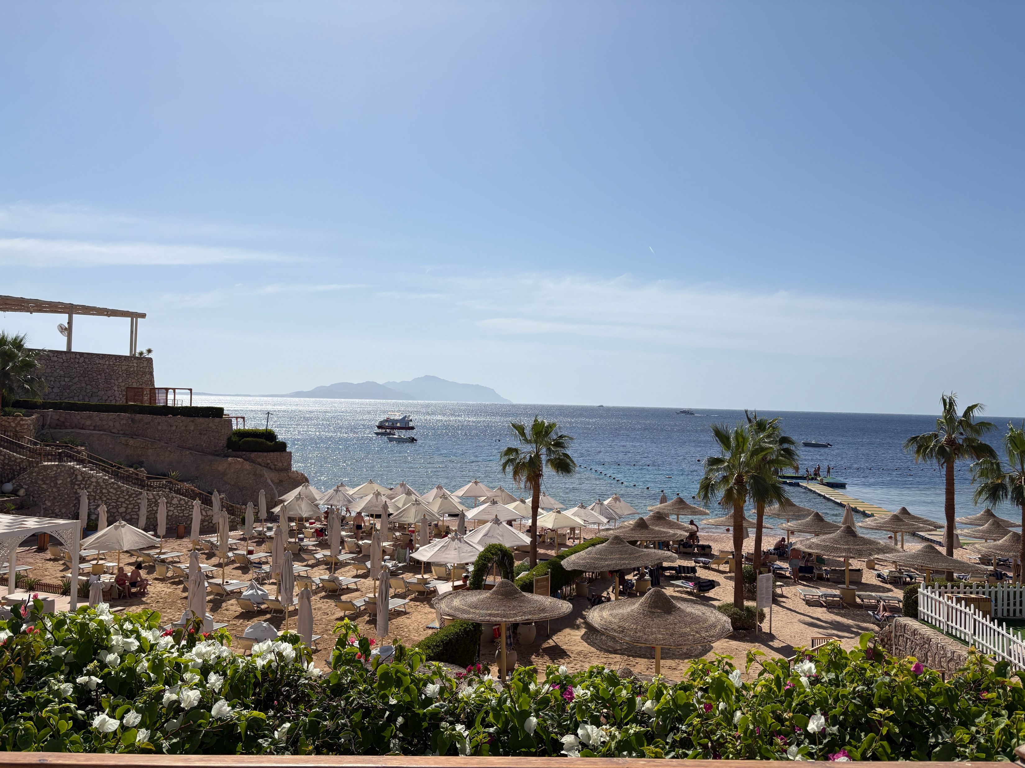
ESAVA Kahun 2nd Congress in Cairo
Notes:
Now that the congress has concluded, the ESAVA is already looking ahead. They have asked the AVA to be their educational partner for the next congress. Plans for the next edition are already underway, with the chosen location set on the beautiful Red sea, proudly named the merer Edition. Stay tunes- it promises to be something truly special.
During this congress , the AVA also offered 10 complimentary memberships to the top performers of the quiz held at our booth, a gesture that was warmly received and helped spark lively engagement throughout the event. We left Kahun with more than professional connecvtions- we left with genuine friend. The organisers and participants showed an incredibly commendable and optimistic attitude, deeply dedicated to learning and to improving the quality of care delivered across the profession. Their warmth, curiosity, and generosity created an atmosphere where meangful dialogue flourished and where inter-speciality collaboration felt not only possible but natural.
We also succeeded in building bridges with the algerian federation of veterinarians and the emirated veterinary association (EVA), both of whom show tremendous promise. They are already preparing an impressive congress for 2028, and the early conversation suggest exciting opportunities for future regional partnerships and shared initiaves. The momentum created in kahun marks the beginning of a stronger, mnore connected veterinary community across North Africa and Middle east- one driven by collaboration, education, and shared vision for better patient care.

Slide 35
  New members
  VAA Editorial Report
  Project update
  Call for new Trustees
  Treasurer’s Report
  AVA Foundation Report

Slide 36

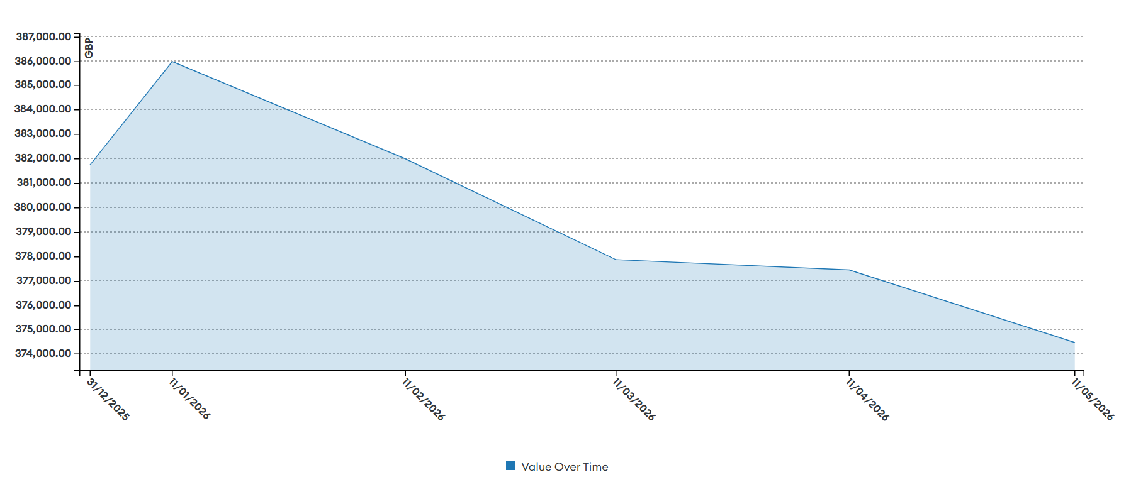

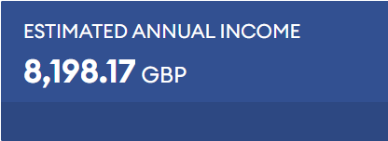
Investment Update

Slide 37
Investment Update
 | May 2026 | Nov 2025 | End 2024
AVA | £ 179,993 | £ 180,986 | £ 173,333
AVA Foundation | £ 194,470 | £ 197,340 | £ 186,830
Total | £ 374,464 | £ 378,326 | £ 360,163

Slide 38

Bank accounts
Update
 | May 2026 | Nov 2025 | 2024
CAF AVA account | £ 58,240 (18’628 VAA) | £ 88,078 | £ 169,622
CAF AVA Foundation account | £ 33,545 | £ 38,619 | £ 36,607
CAF AVA savings account | £101,755 | £ 100,912 | NE
Notes:
The £ 18’628 are the leftovers from the Elsevier Stipend so are technically VAA money

Slide 39
AVA Bank Account
Currently low balance
Payments expected soon
Diplomate membership payments from ECVAA
Liverpool meeting prepayments payback
VAA Royalties 2025

Slide 40
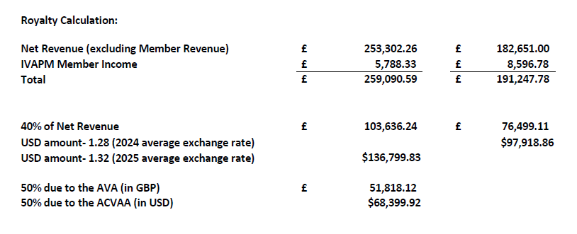
VAA Royalties
2025 | 2024 | 2023
£ 51,818 | £38,249 | £36,103
2025
2024
12.5% to be transferred to ECVAA

Slide 41
Elsevier Stipend VAA
Payments made so far:
  Two Editors in Chief, stipends for January- April
  16 Associate Editors, yearly stipend
  Expense claims for courses and meetings
  International transfer fees

Slide 42
  New members
  VAA Editorial Report
  Project update
  Call for new Trustees
  Treasurer’s Report
  AVA Foundation Report

Slide 43
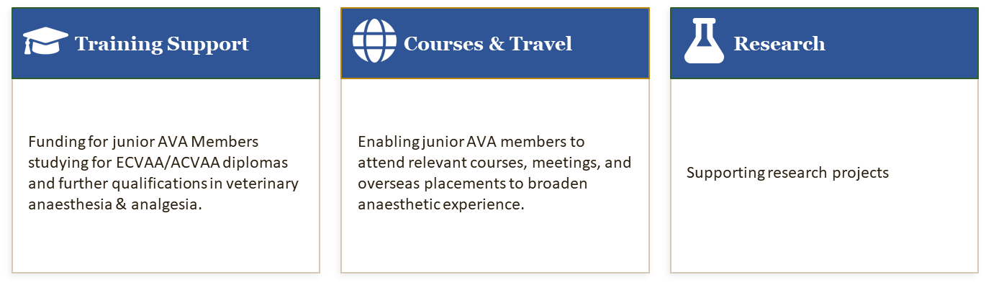
About the AVA Foundation
Application closing dates: 31 January (spring) | 30 June (autumn)

Slide 44
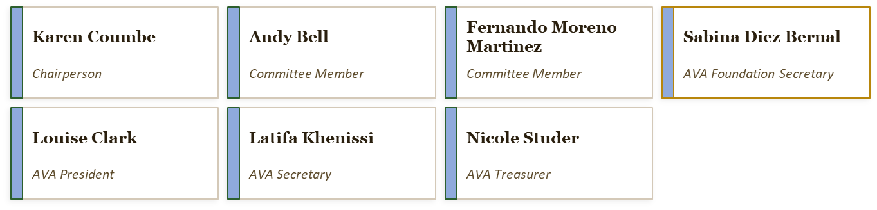
AVA Foundation Committee

Slide 45
AVA Foundation- Awards January 2026
Recipients | Purpose | Amount awarded (£)
Smaragda Karamanidou | Externship | 500
Laura Michele Stadler | Externship | 500
Bartlomiej Liszka | Locoregional Anaesthesia Course | 880
Hannah Marie Fisher | Externship | 750
Cristian Cabellos Clemente | Externship | 750
Katherine Fleck | AVA Meeting Liverpool | 400
Mariafrancesca Petrucci | Externship | 500
Reports from previous recipients can be found on the AVA website.

Slide 46

AVA Foundation – Financial Support
A heartfelt thank you to our generous donor
We are deeply grateful to Khursheed Mama for her generous donation made in memory of Liz Leece
Why your support matters more than ever
Traditionally the Foundation relied on profits from AVA meetings. As the Association has grown, running meetings at significant profit has become much harder. We actively welcome support from individuals and commercial sources to sustain our educational mission.
How to Make a Donation
Online: AVA website AVA Foundation Donation : Association of Veterinary Anaesthetists QR code
The foundation is always looking to grow, and every contribution, large or small, makes a real difference to trainees in our specialty.
Questions? AVAFoundation@ava.eu.com

Slide 47
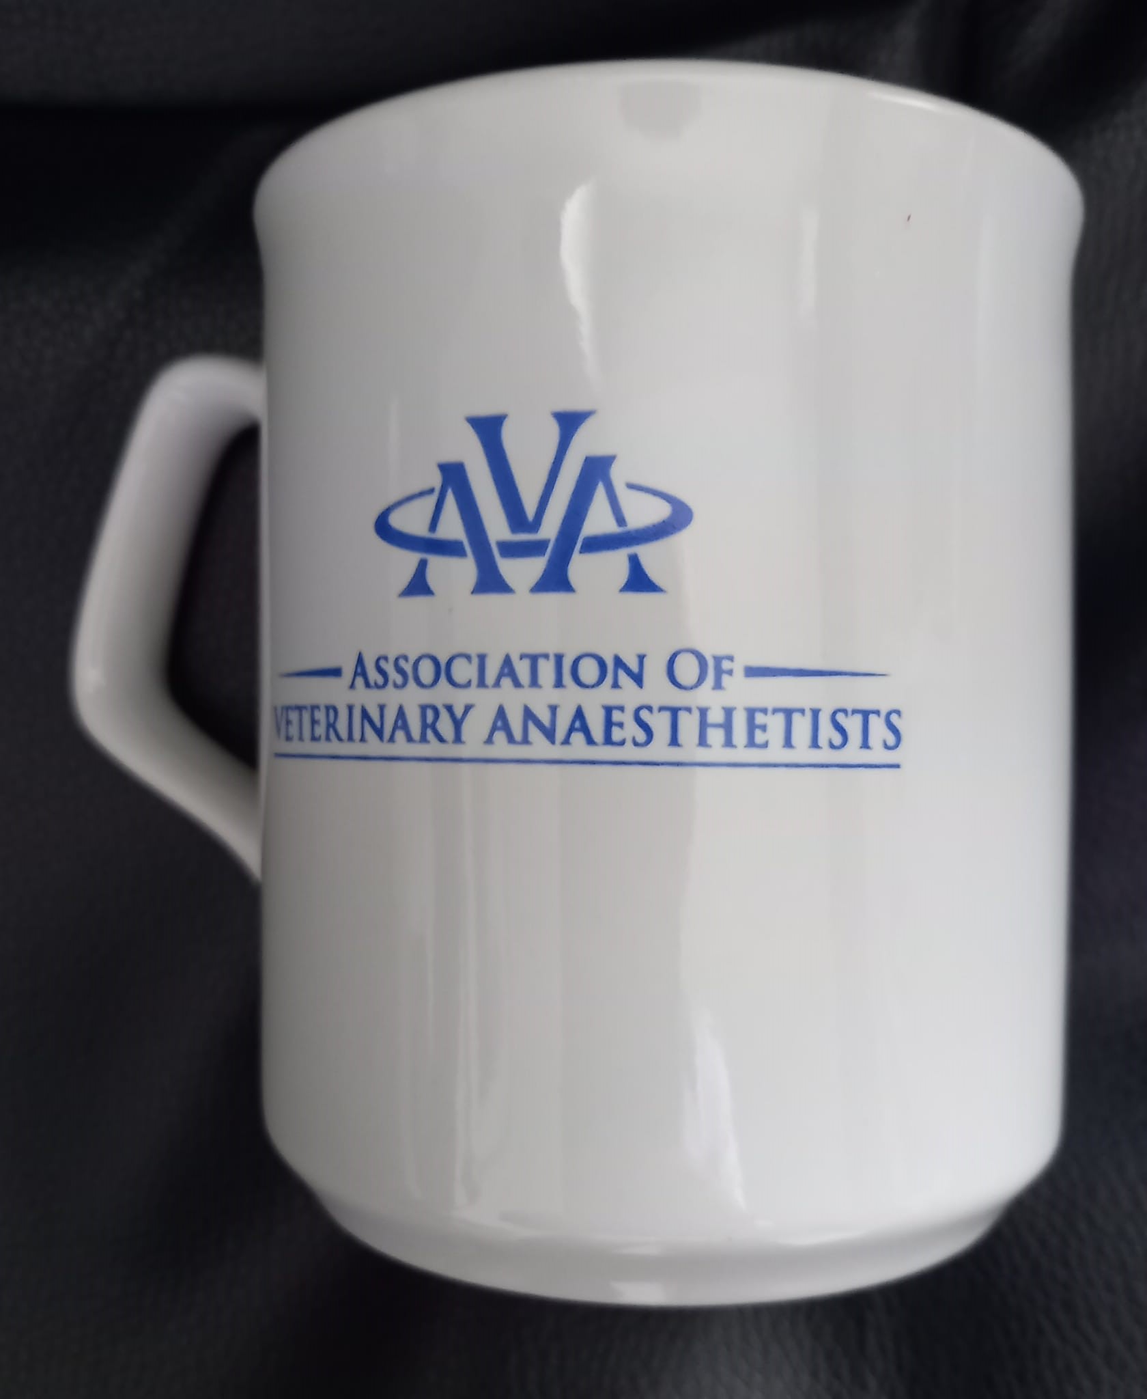
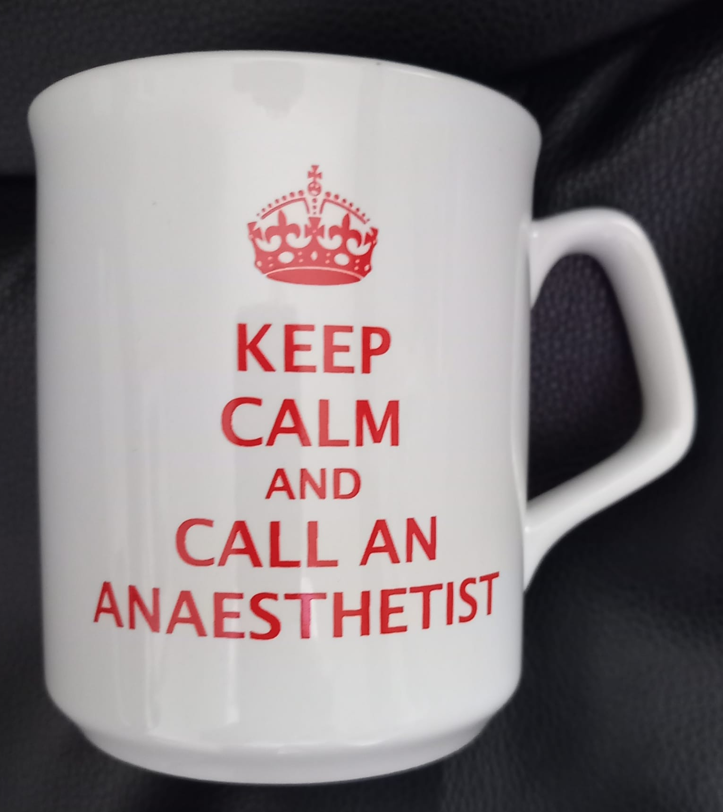
Support the AVA Foundation - Get Your AVA Mug!
Make a difference while attending the congress
Scan the QR code to visit the AVA donation page:
How it works:
Make a donation of at least £8
Show your payment receipt as proof of donation
Receive your exclusive AVA mug at the registration desk
Important:
Please keep your receipt (digital or printed), as it is required to claim your mug.
AVA mugs are available while stocks last

Slide 48
  New members
  VAA Editorial Report
  Project update
  Call for new Trustees
  Treasurer’s Report
  AVA Foundation Report

Slide 49
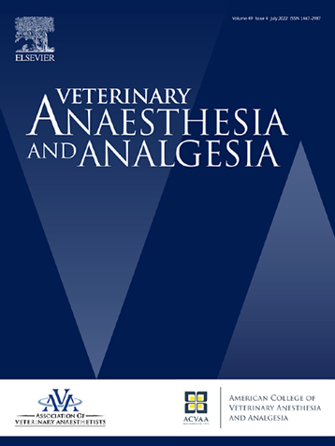
Editor’s report

Slide 50
VAA update – Open Access fees
Full Article Processing Charge (APC) is USD$3300 (original research article)
Discounted APC for AVA members/ACVAA Diplomates: USD$1782 (46% discount)
Manuscripts submitted by non-members are discounted (45%) until 31st December, 2027
ECVAA will pay APC for each resident’s first paper.

Slide 51
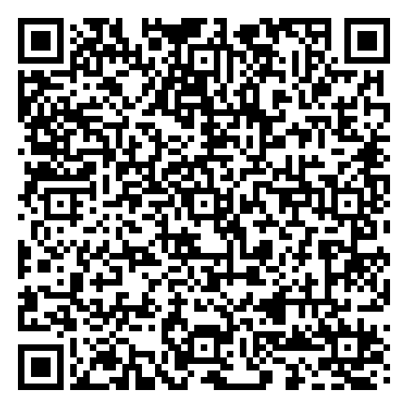
Simplifying submissions:
A template for preparing case reports is available.
A template for original research manuscripts:

Slide 52
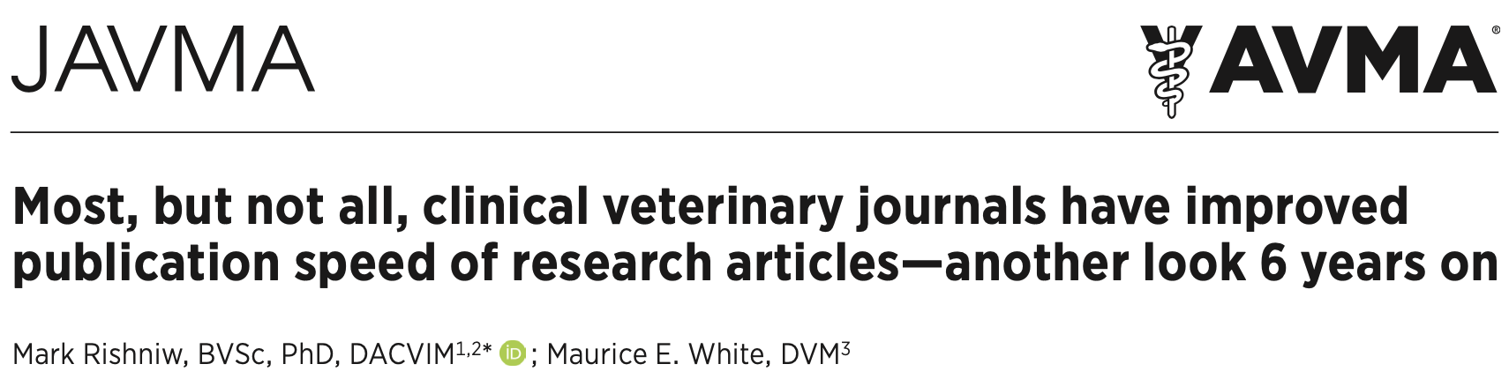
Speeding up manuscript handling:
Manuscript handling time
Rate limiting steps:
Finding reviewers* – please accept/decline invitations quickly.
Time in review, but also time to perform revisions.
Ultimately, improvements in manuscript handling time are a community effort.
Notes:
*increased number of points awarded for serving as a VAA reviewer by ECVAA

Slide 53
Journal website:
Currently 2 sites
  https://www.sciencedirect.com/journal/veterinary-anaesthesia-and-analgesia
    Up to date, permanent site
  https://www.vaajournal.org/
    Will be closed
Notes:
Stated verbally At AVA Vienna meeting – Ludo is thanked for her considerable work supporting the journal as both an Assoc Editor, but also in driving the production of podcasts.

Slide 54
Manuscript Types – 2025 – Submissions
Manuscript type | Number of manuscripts | Percentage (%)
Research study | 159 | 64.1
Short communication | 19 | 7.7
Review article | 10 | 4
Letter to the Editor | 27 | 10.9
Case report | 29 | 11.7
Perspectives | 4 | 1.6
Total | 248 | 100
Note: 2026 submissions reduced by 24.5% versus last 5 years
Notes:
Data from Wes

Slide 55
Acceptance / Rejection rates
Year | Accept | All Rejects | Reject & resubmit | Reject - out of scope | Total final decisions | Accept %
2025 | 129 | 107 | 56 | 0 | 236 | 55
2024 | 133 | 98 | 57 | 5 | 231 | 58
2023 | 50 | 64 | 36 | 2 | 114 | 44
2022 | 76 | 111 | 70 | 7 | 187 | 41
Data based on decision date, not submission date

Slide 56
Origin of Submissions (2025) – top 10
Country | Number of submissions | Percentage
USA | 43 | 17.3
Brazil | 37 | 14.9
UK | 23 | 9.3
Spain | 19 | 7.7
Italy | 12 | 4.8
Canada | 11 | 4.4
Switzerland | 9 | 3.6
Turkey | 9 | 3.6
Iran | 7 | 2.8
Republic of Korea | 6 | 2.4
}
41.5%
Notes:
Plus submissions from 27 other countries

Slide 57
Reviewer Acknowledgements
Reviewer acknowledgements – published in Vet Anaesth Analg in the new year.
Reviewer certificates – available if needed for reaccreditation etc.
  These can be downloaded from Editorial Manager

Slide 58
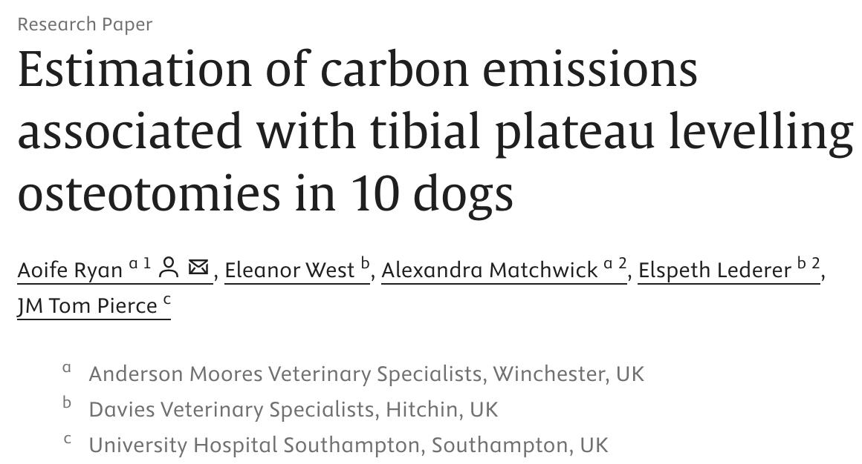
The Colonel John Langley Prize
– Best basic science/research paper
– sponsored by the AVA Foundation
Notes:
This is the first study of its kind in veterinary anesthesia looking at carbon footprint. Investigating the carbon impacts in human anesthesia has substantially changed practice. This study has the ability to impact how veterinary anesthesia is practiced worldwide and to encourage carbon-reducing methods.

Slide 59
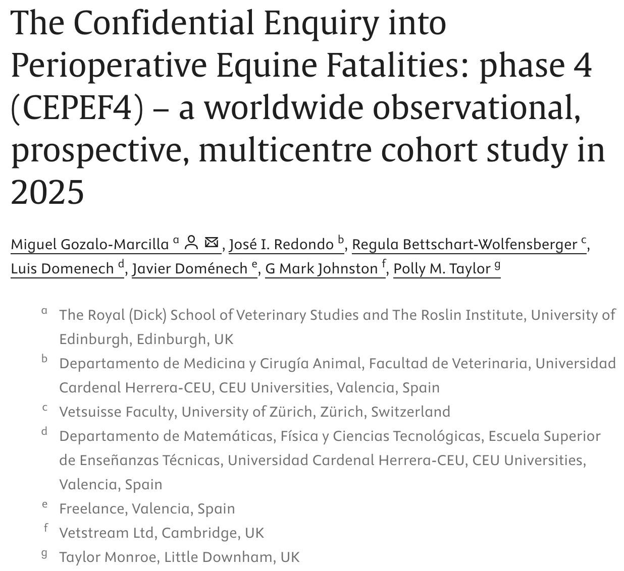
Presidents’ Prize
– Best clinical paper
Notes:
Horses continue to have a high rate of perianesthetic -related morbidity and mortality. However, the updated CEPEF4 study shows improvements in perianesthetic-related morbidity and fatalities during the 20 years since the initial CEPEF study and could become the basis for a mortality risk calculator for equine surgery.

Slide 60
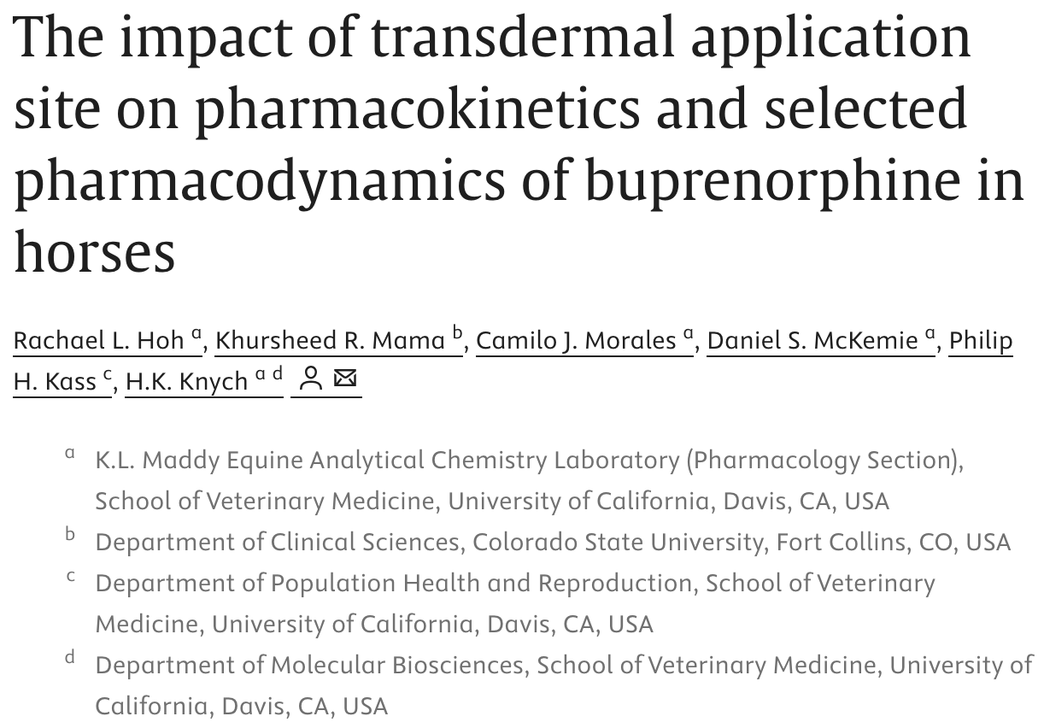
The Dechra Prize
– Best analgesia paper
Notes:
This was a study that was very specifically and intricately designed to detect small variations in PD/PK of dermally administered buprenorphine. Useful information to support a novel analgesia method in horses.

Slide 61
Acknowledgments:
Thank you to all the Associate Editors and reviewers
Assoc Editors:
  Farewell to Jennifer Hess (USA), Keila Ida (USA), Peter Pascoe (USA).
  Welcome to Aya Oda (Japan), Vaidehi Paranjape (USA), Kate Walters (NZ)
  Barbara Cuniberti – handling annual journal awards
  Natali Verdier – assisting DP with review oversight

Slide 62
Associate Editors:
Now a paid role (USD$1000/year)
Currently 16 Assoc Editors:
  B Cuniberti, S Gibson, A Oda, C Kerr, J Michou, V Paranjape, N Pavlisko, B Pypendop, J Robertson, S Shippy, J Soares, H Tayari, N Verdier, K Walters, G Zeiler, A Zoff
Notes:
Stated verbally At AVA Vienna meeting – Ludo is thanked for her considerable work supporting the journal as both an Assoc Editor, but also in driving the production of podcasts.

Slide 63
Questions/comments?
Daniel Pang: eic.vaa@ucalgary.ca

Slide 64
  New members
  VAA Editorial Report
  Project update
  Call for new Trustees
  Treasurer’s Report
  AVA Foundation Report

Slide 65
Trustee Vacancies
Junior Vice President
Honorary Secretary
General Members
January 2027……
Points for accreditation
Contribution to and involvement with the Global Veterinary Anaesthesia Community
Ability to create and bring to fruition your own projects
Please e mail: "AVA Honorary Secretary" at secretary@ava.eu.com

Slide 66
Future meetings
Autumn 2026: THESSALONIKI, 30th September to 2nd October 2026
Spring 2027: OSLO, 19th – 21st May 2027
Autumn 2027: EDINBURGH (joint Glasgow team), early-October 2027 (6th–8th)
Spring 2028: BUCHAREST, May 2028
Autumn 2028: TORONTO, September 19th – 22nd 2028, WCVAA

Slide 67
  Apologies - Previous Minutes - New members
  AVA Foundation Report
  2025 debrief (IS JVP)
  VAA Editorial Report
  President’s Report
  ECVAA Report
  Treasurer’s Report
  Correspondence - Other Business - Questions

